Slide 1
Presentation 1
Chris White
Office for National Statistics

Slide 2
Mortality trends and inequality:
Changing trends in mortality rates
Chris White
Health and Life Events Division

Slide 3
Background
Mortality rates were steadily falling during 20th and early 21st Centuries
Because of this life expectancy has steadily grown
  Life Expectancy at birth in 1900 was 48 years for males but by 2016 had increased to 79 years
  Infant mortality reduced from >150 deaths per 1000 to <4/1000
  Deaths in adults also reduced markedly through better living standards, improvements to health care and its access as well as behavioural changes such as reductions in smoking and dietary changes

Slide 4
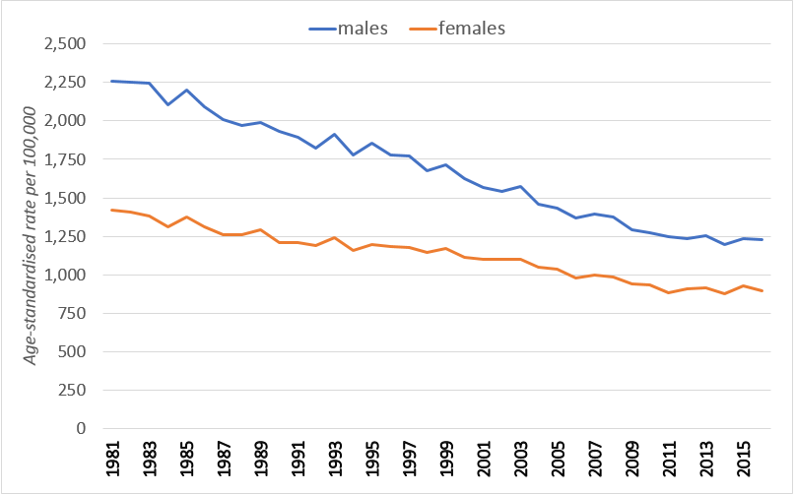
Trend 1981-2016 age-standardised mortality rates: Wales
Notes:
Looking at mortality over the last 30 years, the rates for both men and women have both consistently fallen.

Slide 5
The Issue (1)
Since 2011 there have been noticeable changes:
  Overall improvement stagnating
  Pattern becoming less regular with an abrupt fall then sharp increase between 2013 to 2014 and 2014 to 2015
  Rates in 2015, 2016 and 2017 remain higher than 2014 and Q1 2018 is highest rate since 2009
Evidence clear that the familiar reductions observed before the 2010s are not occurring in the same way this decade

Slide 6
The Issue (2)
Wide interest in recent mortality patterns
2015 mortality rose and life expectancy fell
Debate on explanations heated and polarised
  Austerity (see Dorling and Hiam 2017)
  NHS and Social Care pressures
  Influenza strains, immunisation efficacy and uptake
  Cohort effects
  Gains resulting from fewer people smoking wearing off
No official statement on a definitive change by a government agency
Notes:
There has been wide interest in recent mortality patterns, particularly following analyses of 2015 deaths, which produced a statistically significant rise in mortality rates and a consequential fall in life expectancy in England between 2014 and 2015. A number of influential organisations and academics have provided commentary and analysis on these trends, including the Institute and Faculty of Actuaries and their continuous mortality investigation, and there is accompanying industry commentary on this: think tanks such as the King’s Fund; academics such as Sir Michael Marmot; as well as public bodies such as Public Health England and Public Health Wales.
There has understandably been speculation about the reasons behind the observed patterns. Some researchers have pointed to the presence of more virulent strains of influenza affecting the more vulnerable older populations. However, this is contested as a long-term effect as varying predominant strains of influenza will only explain short-term fluctuations in mortality rates, not longer-term changes in trends (see Rise in mortality in England and Wales in first seven weeks of 2018).
Several authors suggest austerity as the primary underlying cause of more recent mortality patterns, citing statistical associations with measures of healthcare performance and the worsening financial performance of NHS bodies, together with social care access constraints, as discussed in Effects of health and social care spending constraints on mortality in England: a time trend analysis. On the other hand, others have argued that such analysis does not demonstrate causal links.
A third approach attributes the trends to cohort effects, specifically higher prevalence of co-morbidity among the elderly. The risk of multi-morbidity with increasing age is found across European countries, and the higher concentrations of older people in modern economies present challenges for health and social care systems.

Slide 7
Objectives
Has there been a significant change in trend between 1990 and 2017?
If yes:
  when did it occur
  Is the change and timing different for males and females, young (0 to 74) and old (75+), England and Wales

Slide 8
Data & Methods used
Age-standardised mortality rates
  For “quarterly rolling annual periods”. From Q1 1990 to Q4 1990 till Q1 2017 to Q4 2017.
  For 109 rolling data points
Segmented function and the Davies test
  Iteratively fits linear models to continuous data, joined at breakpoints
  Davies test looks at a range of points in the time series and returns the significance of the “best” break point from all points tested.
Notes:
Segmented linear regression fits multiple linear regression models to a series of continuous data points to determine a trend using a segmented or broken line of best fit. The point at which one segment meets the next is called a breakpoint and indicates the point of a change in trend where the difference in the coefficients of the slopes before and after the breakpoint is statistically significant.

Slide 9
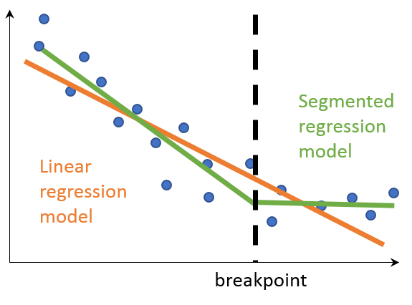
Example of a segmented regression analysis
Notes:
As shown in figure above, the orange line is a single linear regression model produced to fit all the data (blue dots). The green line is a segmented regression model produced to fit the data assuming there is one breakpoint in the data. Overall, the green line fits the data much better than the orange line with many more blue data points being closer to the green line than the orange line. The dashed black line shows where the change in trend (breakpoint) occurred. The exact position of this breakpoint does not precisely locate any source of change, but can be used to see whether there is consistency across different countries, sexes and age groups about where the change in trend occurred in the time series.

Slide 10
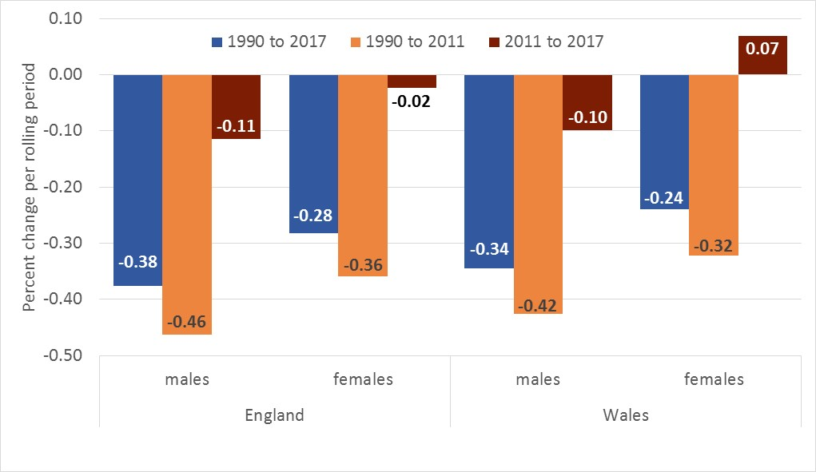
Results - descriptive

Slide 11
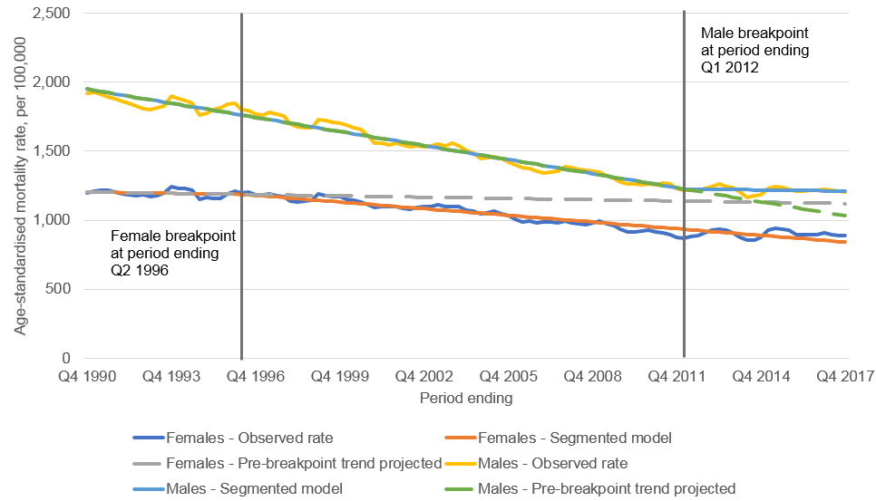
Segmented regression analysis – Wales (all ages)

Slide 12
Breakpoints – Wales
Age | Sex | Breakpoint | Lower 95% confidence limit | Upper 95% confidence limit
All ages | Males | Q2 2011 to Q1 2012 | Q2 2010 to Q1 2011 | Q2 2012 to Q1 2013
All ages | Females | Q3 1995 to Q2 1996 | Q3 1993 to Q2 1994 | Q4 1997 to Q3 1998
0 to 74 years | Males | Q1 2010 to Q4 2010 | Q2 2009 to Q1 2010 | Q3 2010 to Q2 2011
0 to 74 years | Females | Q3 2011 to Q2 2012 | Q3 2010 to Q2 2011 | Q3 2012 to Q2 2013
75 years and over | Males | Q3 2011 to Q2 2012 | Q4 2009 to Q3 2010 | Q2 2013 to Q1 2014
75 years and over | Females | Q3 1998 to Q2 1999 | Q2 1996 to Q1 1997 | Q4 2000 to Q3 2001

Slide 13
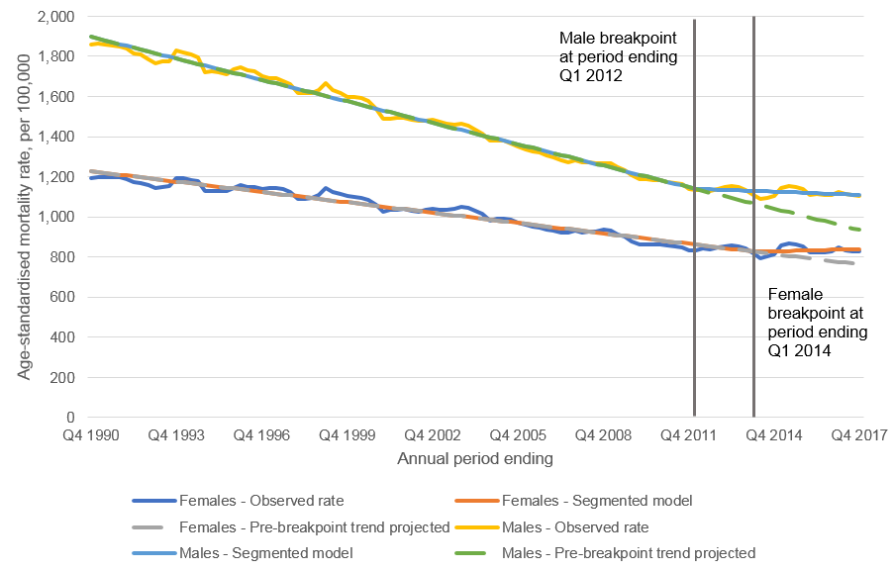
Segmented regression analysis – England (all ages)

Slide 14
Breakpoints - England
Age | Sex | Breakpoint | Lower 95% confidence limit | Upper 95% confidence limit
All ages | Males | Q2 2011 to Q1 2012 | Q3 2010 to Q2 2011 | Q1 2012 to Q4 2012
All ages | Females | Q2 2013 to Q1 2014 | Q1 2012 to Q4 2012 | Q3 2014 to Q2 2015
0 to 74 years | Males | Q2 2009 to Q1 2010 | Q1 2009 to Q4 2009 | Q4 2009 to Q3 2010
0 to 74 years | Females | Q2 2011 to Q1 2012 | Q3 2010 to Q2 2011 | Q4 2011 to Q3 2012
75 years & over | Males | Q3 2011 to Q2 2012 | Q3 2010 to Q2 2011 | Q3 2012 to Q2 2013
75 years & over | Females | Q2 1998 to Q1 1999 | Q2 1995 to Q1 1996 | Q2 2001 to Q1 2002

Slide 15
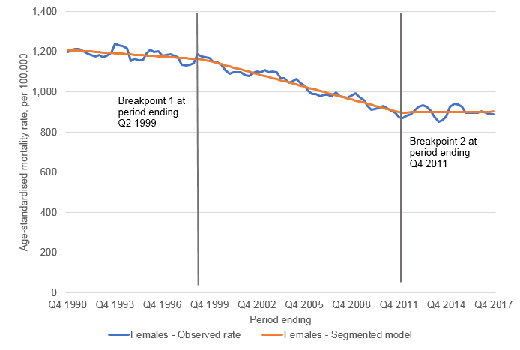
When two breakpoints are allowed…
Country | Sex | Age range | Break point 1 | Break point 2
Wales | Female | All | Q3 1998 to Q2 1999 | Q1 2011 to Q4 2011
England | Female | 75+ | Q1 2003 to Q4 2003 | Q4 2010 to Q3 2011
Wales | Female | 75+ | Q3 2002 to Q2 2003 | Q4 2010 to Q3 2011
Notes:
The graph shows Females in Wales (all ages)

Slide 16
Conclusions
9 of the 12 demographic and geographical breakdowns showed a clear change in mortality trend that began in the early 2010s when only one breakpoint in the series was requested from the program’s algorithm.
The other three showed a change at around the same time, but in addition to a change in the 1990s or early 2000s, when two breakpoints were requested from the program.
This provides independent evidence that there has been a significant reduction in mortality improvements compared with the durable, long-term mortality declines observed in the decades preceding 2010.
The findings were common to males and females and to those aged under 75 years and aged 75 years and over alike, suggesting that this change – whatever its cause – is not restricted to certain demographic groups but is more widespread.

Slide 17
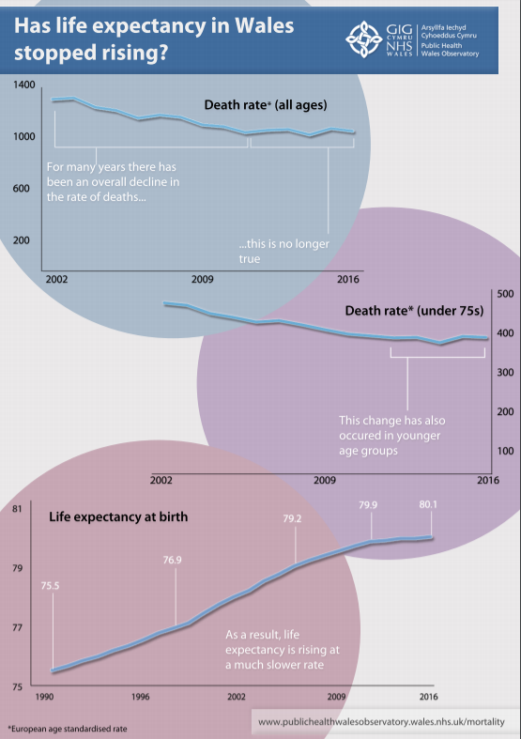
Findings from PHW

Slide 18
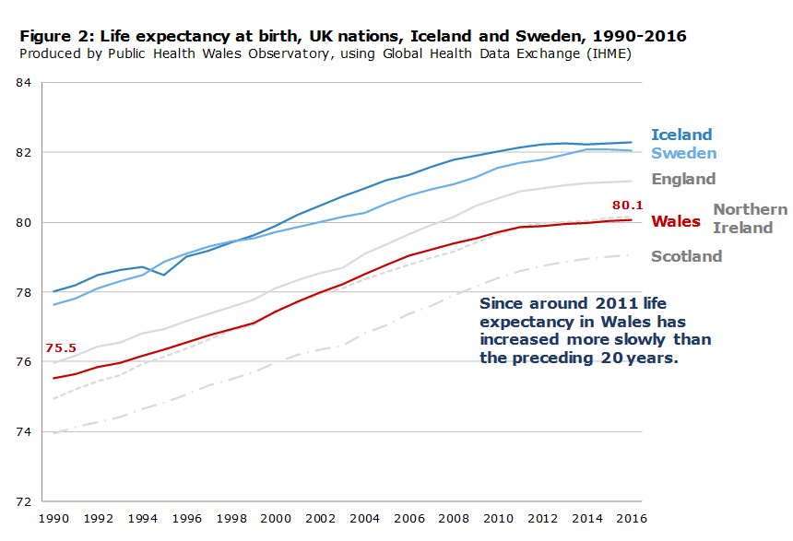
Findings from PHW

Slide 19
Additional work by ONS
International comparisons of mortality rates and life expectancies: https://www.ons.gov.uk/peoplepopulationandcommunity/birthsdeathsandmarriages/lifeexpectancies/articles/changingtrendsinmortalityaninternationalcomparison/2000to2016
Comparisons of mortality rates within the UK countries: https://www.ons.gov.uk/peoplepopulationandcommunity/birthsdeathsandmarriages/lifeexpectancies/articles/changingtrendsinmortality/acrossukcomparison1981to2016
  - At the country level, England and Wales have seen a greater slowdown in overall mortality improvements for males compared with Northern Ireland and Scotland.

Slide 20
Next steps
ONS plans to investigate this further by looking at:
the trend in life expectancy by the National Statistics Socioeconomic Classification to encompass the period 2012 to 2016
age decomposition of life expectancy and estimation of the contributions of period and cohort effects
Segmented regression analysis for regions of England to assess whether there are geographical differences

Slide 21
Mortality trends and inequality:
Illustrations of inequalities in avoidable mortality and health state life expectancy
Chris White
Health and Life Events Division

Slide 22
Avoidable Mortality
How do we define avoidable mortality?
  Amenable - deaths that, in light of medical knowledge and technology currently available, all or most from specific causes could be avoided through good quality healthcare
  Preventable - deaths that, in light of current understanding of the determinants of health, all or most from specific causes could be avoided by public health interventions in the broadest sense
  Avoidable - avoidable deaths are all those defined as preventable, amenable or both, where each death is counted only once; where a cause of death is both preventable and amenable, all deaths from that cause are counted in both categories when they are presented separately
Notes:
The concept of avoidable mortality was first introduced by Rutstein and others in the 1970s as an indicator of healthcare quality and effectiveness using lists of diseases which should not (or only infrequently) give rise to death or disability. Rutstein also noted that the list of conditions considered to be avoidable would need to be updated in light of improvements in medical knowledge and practice, as well as social and environmental changes. Although avoidable mortality has been researched for the last three decades, there is little consensus among researchers about how to define it. The list of causes of death ONS use in defining avoidable mortality is primarily based on the cause lists produced by Nolte and McKee (2004) (PDF 852KB) and Page, Tobias and Glover (2006) (PDF 1MB).These cause lists were updated and amended to make them more relevant to the UK and to take account of more recent developments in healthcare public health policy. Changes to these lists were influenced by Wheller and others (2007) and Eurostat as well as views of respondents to the 2011 and 2015 consultations.
It’s common practice to distinguish between avoidable deaths that are either preventable or amenable. Amenable deaths are those that are avoidable through good quality timely healthcare, while preventable deaths are avoidable through broad range public health interventions. Avoidable deaths therefore are the combination of both amenable and preventable deaths

Slide 23
Coverage
Geographic:
  Trend from 2014 to 2016 (update to 2017, February)
  UK and Constituent Countries
    UA’s and Health Boards in Wales
    LAs and CCGs in England
Socioeconomic:
  Based on IMD and WIMD versions
  Trend from 2001 to 2016 (update to 2017, March)
  Age-standardised rates, SIIs and RIIs
Notes:
ONS traditionally produced avoidable mortality estimates for England and Wales, but this was extended for the 2016 release to cover Scotland and Northern and produce a UK estimate. Sub-national areas were also included for the first time too last April, which included Unitary Authorities and Welsh Health Boards. We will extend the trend to 2017 in February next year.
We also sought to establish a trend in avoidable mortality by area deprivation to help inform how much variation existed in the rate of improvement over time and whether the stalling mortality picture was also present across socioeconomic strata and whether the stalling was occurring in younger populations.

Slide 24
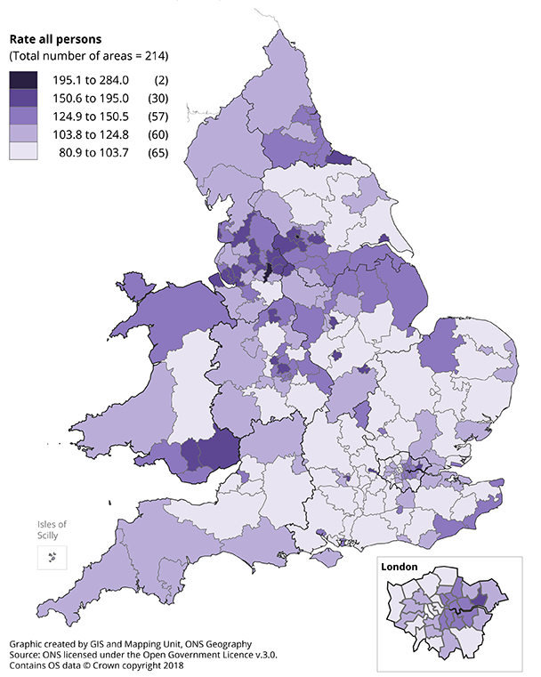
Recent publication content
Local area interactive
Notes:
One feature of the national avoidable mortality release was the ability to use interactive media to compare local areas in England and Wales. East Dorset had the lowest avoidable mortality rate for males of 170.2 deaths per 100,000 while Manchester had the highest at 481.2 deaths per 100,000, 2.8 times higher. In Wales, Monmouthshire had the lowest rate at 232.4 per 100,000, ranked 114th out of all local areas in England and Wales, while Merthyr Tydfil had the highest at 384.4, ranked 335th 65% higher. For females, Chiltern had the lowest avoidable mortality rate of 103.2 per 100,000, and Manchester had the highest at 304.1, almost 3 times higher. In Wales, Powys had the lowest rate at 144.0 per 100,000, ranked 106th while Merthyr Tydfil had the highest at 255.9 per 100,000, ranked 340th 78% higher.
The map on the right shows amenable mortality in 2016 for clinical commissioning groups and health boards in Wales. In Wales Powys teaching had the lowest rates for males and females and cwm taf university the highest.

Slide 25
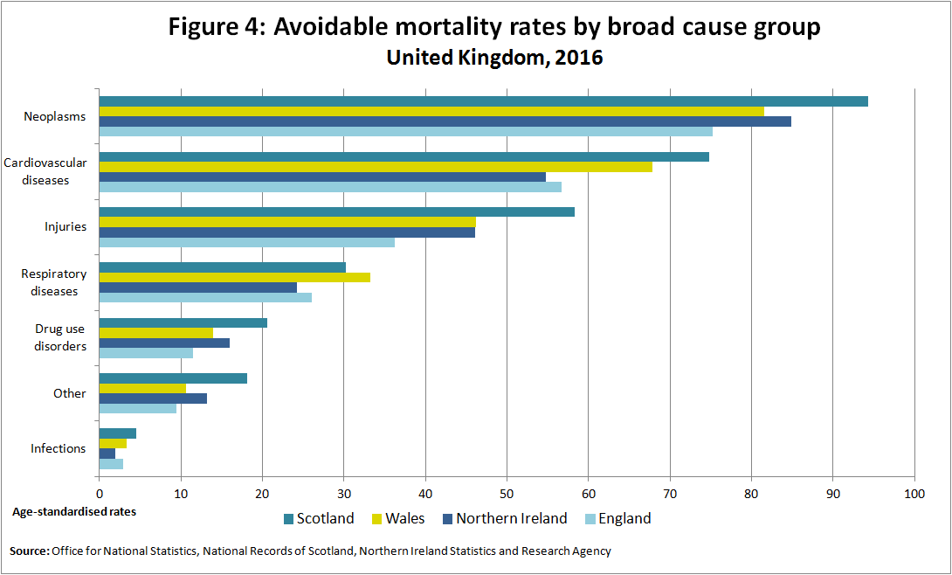
Notes:
This chart shows avoidable mortality rates by broad causes. Avoidable deaths from respiratory diseases was highest in Wales, and increased from 25.2 deaths per 100,000 in 2014 to 33.2 deaths per 100,000 in 2016, an increase of almost a third. Avoidable deaths from injuries have also increased by a quarter in Wales between 2014 to 2016.

Slide 26
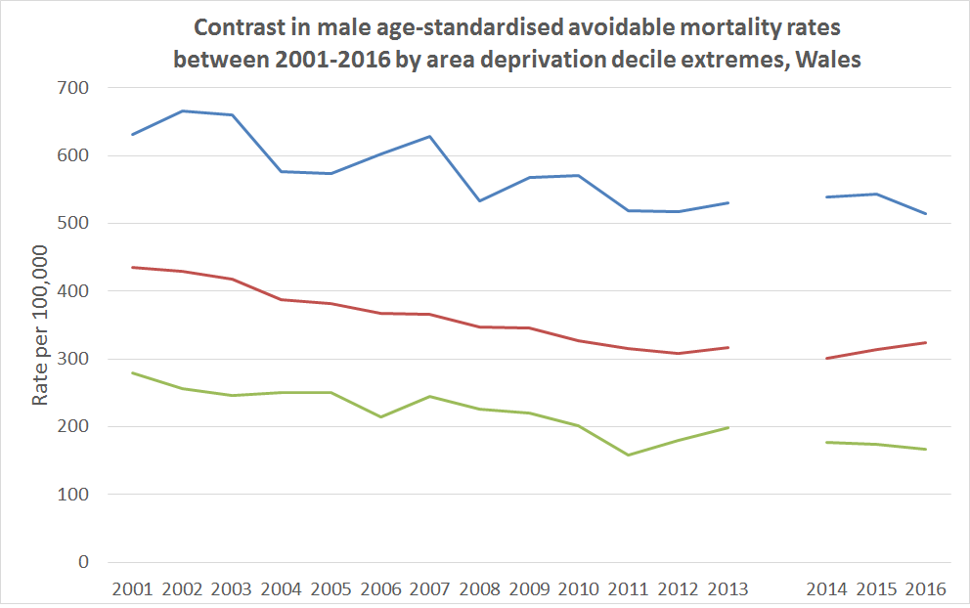
Most deprived
Wales
Least deprived
Notes:
In order to track health improvement with regard to avoidable deaths across different sections of the population, ONS produced estimates of avoidable deaths by WIMD deprivation deciles. This chart shows the trend in avoidable mortality rates for males for the least and most deprived and for Wales as a whole. The pattern has fluctuations but is mostly downward, although in Wales as a whole and for both deciles, there is no evidence of improvement since 2011\2012. Across the whole series though, the most deprived males had rates of death 18.6% lower in 2016 compared with 2001, amounting to 117 fewer deaths per 100,000. This compares to a 40% reduction among the least deprived males, and a gap of 347 deaths per 100,000 in 2016. In Wales there was a 25% reduction.

Slide 27
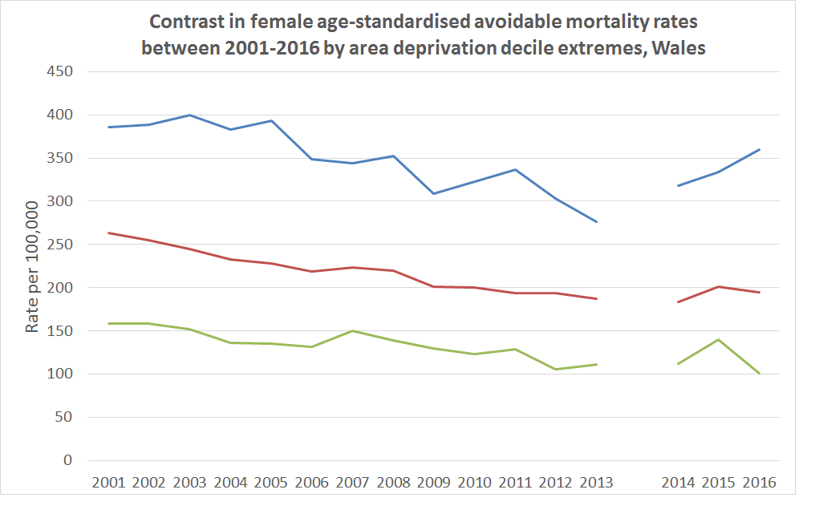
Most deprived
Wales
Least deprived
Notes:
This chart shows the trend in avoidable mortality rates for females for the least and most deprived local areas and for Wales as a whole. The pattern is mostly downward between 2001 and 2013. There was a definition change in 2014 which added intestinal infections, as well as other infections in children such as measles and lower respiratory tract causes, but these additions were found to have minimal impact at national level on rates. A key feature is the consecutive rise in decile 1 female avoidable mortality which places the rate in 2016 higher than in 2006. Decile 10 females have the lowest rate in 2016 across the whole series. Between 2001 and 2013 avoidable mortality rates fell by 28% among the most deprived females, but across the whole series there was only a 6.9% fall. Since 2014 rates have increased by 12%, partly explained by rises in respiratory disease deaths. Among decile 10 least deprived females rates fell by 36.6% between 2001 and 2016, while in Wales the fall was 26.3%. The gap in 2016 was 259 death per 100,000 higher in decile 1 than decile 10, while in 2001 it was 227 deaths per 100,000.

Slide 28
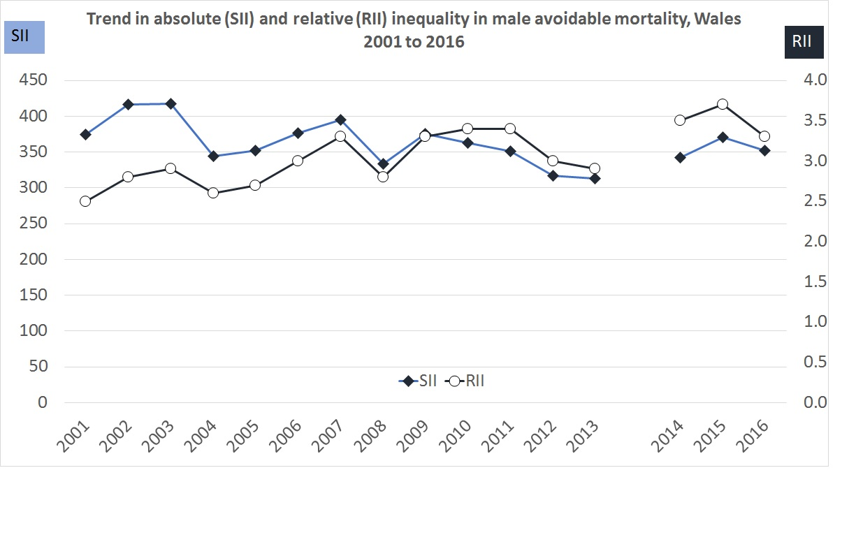
Notes:
Moving on to the absolute and relative gaps based on the Slope Index of Inequality and Relative Index of Inequality. This chart shows the socioeconomic inequality in male avoidable mortality over time. Relative gaps have mostly increased over time and now stand 16% higher in 2016 compared with 2001. Avoidable mortality is now 3.2 times higher among the most deprived males compared with the least deprived. Absolute inequality has fluctuated with consecutive periods of growth and narrowing. The absolute gap fell between 2001 and 2013 by 61.2 deaths per 100,000, reaching 313 deaths per 100,000 but this has since risen in 2016 to 351.9 deaths per 100,000. Between 2001 and 2016 the absolute gap fell by 22.4 deaths per 100,000.

Slide 29
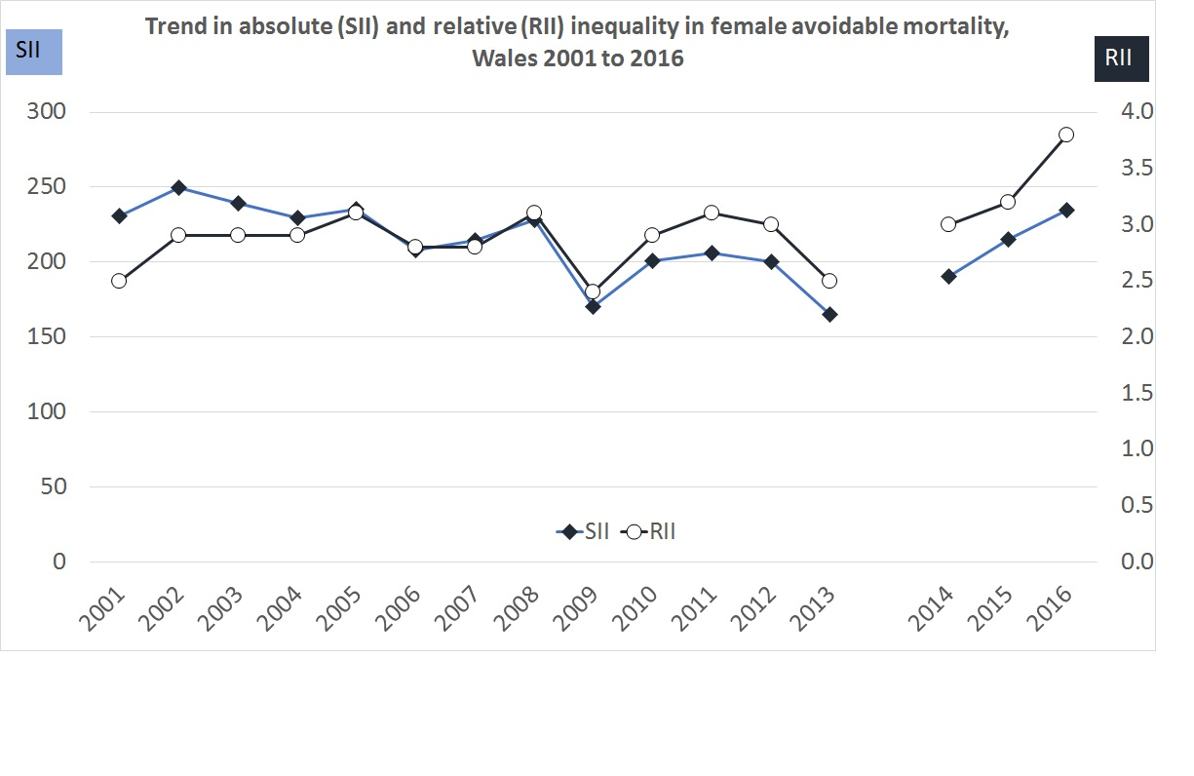
Notes:
This chart shows the socioeconomic inequality in female avoidable mortality over time. Relative gaps in 2001 were of a similar magnitude as in 2013 with a low point in 2009 of 2.4 times higher in the most compared with the least deprived females. However, since 2014 relative gaps have risen and now stand at 3.8 times higher, a gap exceeding the male gap. The rise since 2013 is the largest observed across the whole series. Absolute inequality was mostly downward between 2001 and 2013, with the absolute gap falling 66 deaths per 100,000. Since then it has risen by 69 deaths per 100,000 with the SII now higher in 2016 than in 2001. Clear evidence of rising inequality among females in Wales.

Slide 30
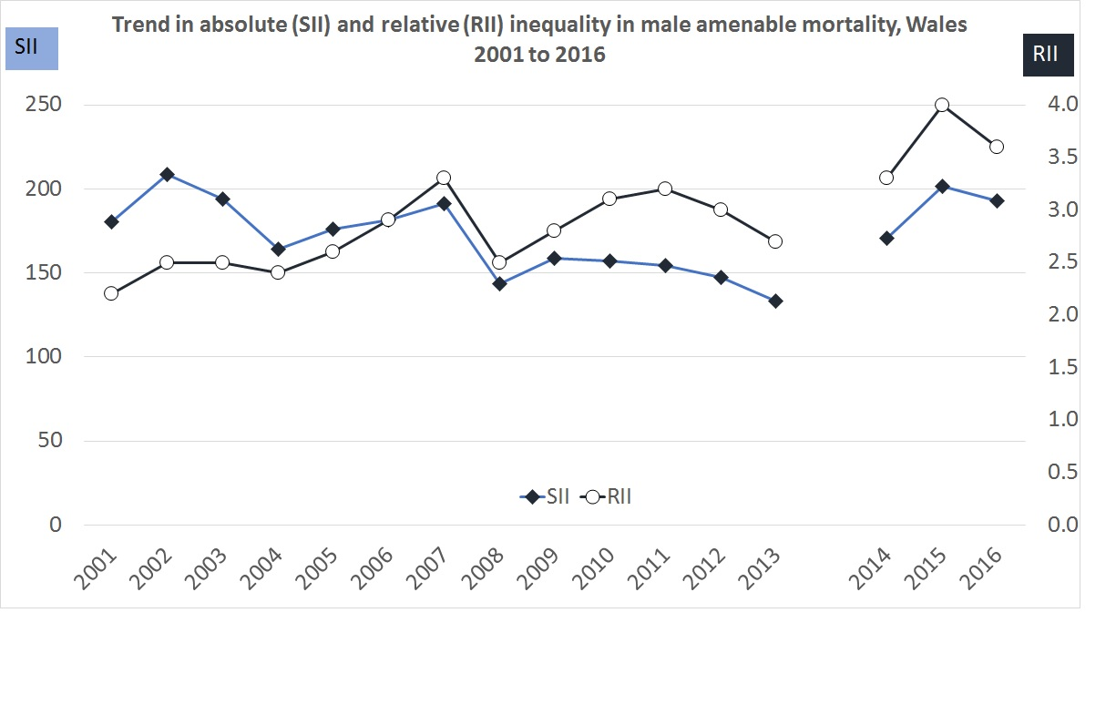
Notes:
This chart shows the relative and absolute inequality in male amenable mortality. Relative gaps were on the rise until 2007 but fell back in 2008 sharply. Since then there was a slight rise to 2013 overall, with relative gaps remaining higher in 2013 compared with 2001, despite substantial falls in the absolute gap. However, since 2013, relative gaps have increased, peaking in 2015 at 4 time higher amenable death rates in the most compared with the least deprived, but now at 3.6 times higher in 2016. This represents a growth in the RII of almost two thirds. Absolute gaps mostly fell between 2001 and 2013, and were lowest in 2013 at 133.1 deaths per 100,000 compared with a rate of 180.3 deaths in 2001, a 47.2 deaths per 100,000 fall. Since then rates have increased by 60 deaths per 100,000 and the absolute gap is now higher in 2016 than in 2001, which makes it distinct from avoidable deaths inequality where the absolute gap was lower in 2016 compared with 2001.

Slide 31
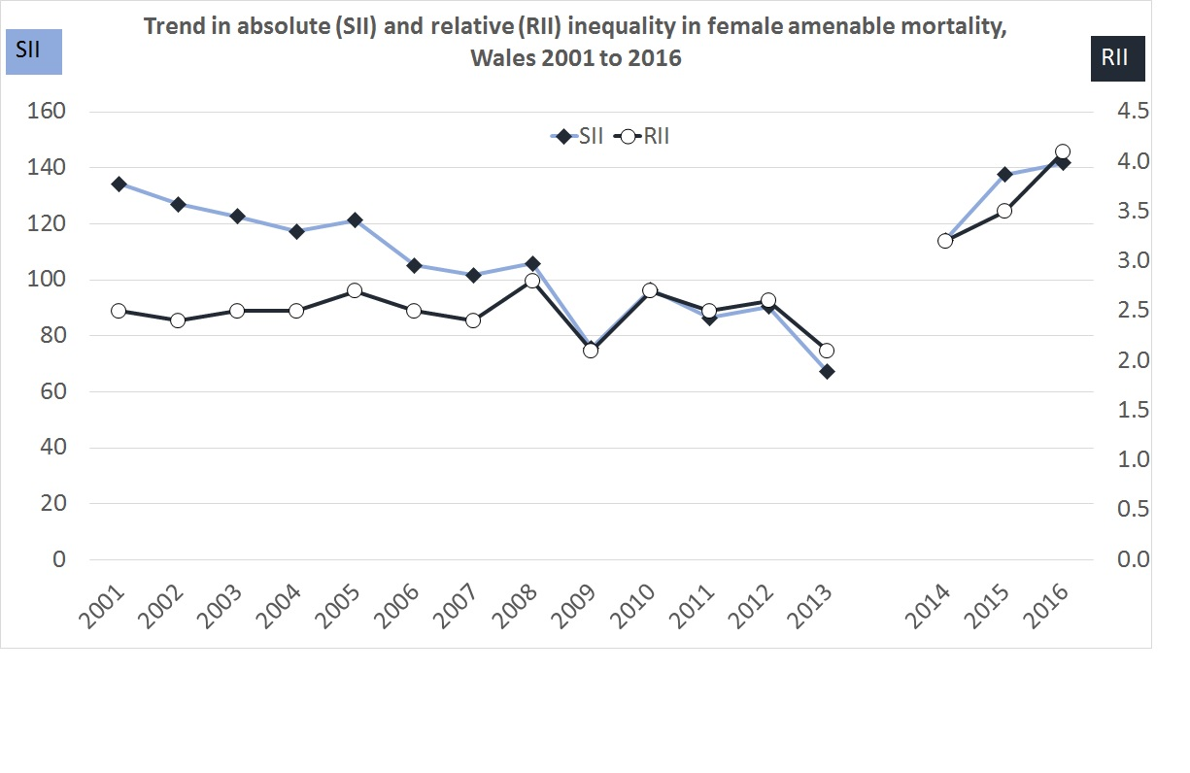
Notes:
This chart shows the relative and absolute inequality in female amenable mortality. Among females, there is clear evidence of narrowing health inequality with regard to amenable mortality between 2001 to 2013. Both the relative and absolute gap contracted. The relative gap decreased from 2.5 times higher to 2.1 times. At the same time there were mostly falls in absolute gaps, from 134 deaths per 100,000 to 67 deaths per 100,000, representing a halving in the inequality. However, the gap was substantially higher in 2014 when the definition change was introduced. Examining the gaps in avoidable causes, cardiovascular diseases, injuries, respiratory diseases and neoplasms avoidable death gaps all increased between 2013 and 2014, causing the increase in the amenable mortality gaps since 2013. By 2016 the relative gap was 4.1 times higher, while the absolute gap was 141.8 death per 100,000, meaning the absolute gap more than doubled in 3 years..

Slide 32
Health State Life Expectancy
Measures:
  Life Expectancy
  Healthy Life Expectancy\Proportion of life spent healthy
  Disability-free life expectancy\Proportion of life spent disability-free
Coverage
  Geographic
  Socioeconomic
Notes:
Another tranche of work we undertake is reporting health state life expectancy. The release encompasses a number of metrics including traditional life expectancy as well as alternative measures such as the median and modal ages at death, health life expectancy and the proportion of life spent healthy and disability-free life expectancy and the proportion of life spent disability-free. Healthy life expectancy is a measure of subjective health related well-being and disability-free life expectancy is a measure of life free from functional limitation. All three measures are high level health outcome indicators used in policies such as the state pension age review and form part of the public health outcomes framework. The coverage is spatial and socioeconomic.

Slide 33
Geographic Coverage
UK, constituent countries, regions
  Trend in life expectancy 2001-03 to 2014-16
  Trend in HLE and DFLE 2009-11 to 2014-16
England’s local authorities
  Trend in life expectancy 2001-03 to 2014-16
  Trend in HLE and DFLE 2009-11 to 2014-16
Wales’ Unitary Authorities\Health Boards
  Trend in life expectancy 2001-03 to 2014-16
  Trend in HLE and DFLE 2011-13 to 2014-16
Notes:
There are also Scotland’s council areas and Northern Ireland’s local government districts.

Slide 34
Geographic Content
Local area interactive
Local area interactive showing gain

Slide 35
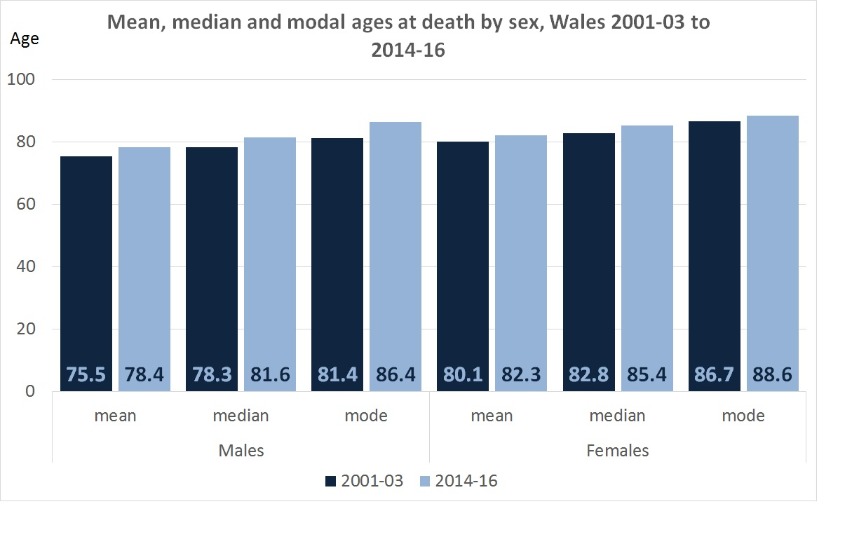
Notes:
This chart shows two additional measures of longevity which we introduced to the release following a request from the department of work and pensions to examine at what age would half a hypothetical cohort still be alive and at what age do most people die. These estimates were constructed using an abridged life table closed at 95+, whereas the sub-national estimates are produced using an abridged life table closed at 90+. As can be seen there have been substantial increases in mean male and female life expectancy between 2001-03 and 2014-16 of 2.9 years and 2.2 years respectively. The median life expectancy is higher than the mean life expectancy as this is showing the age at which half a cohort would still be alive, which is influenced much more by older age mortality. In 2001-03 half a male cohort would be expected to survive to the age 78.3, increasing to 81.6 in 2014-16, while for females it grew from 82.8 to 85.4 years. The modal age at death is even higher, and showed substantial gains for males, meaning that most men now die at age 86.4 years, compared to 81.4 years in 2001-03. For females the mode increased much more slowly from 86.7 in 2001-03 to 88.6 years in 2014-16. This chart does indicate the majority of people will exceed average life expectancy which is important for pensions and social care planning. What is striking is the large gain in male modal ages at death compared with women meaning many more men are now surviving to oldest old age group 85+.

Slide 36
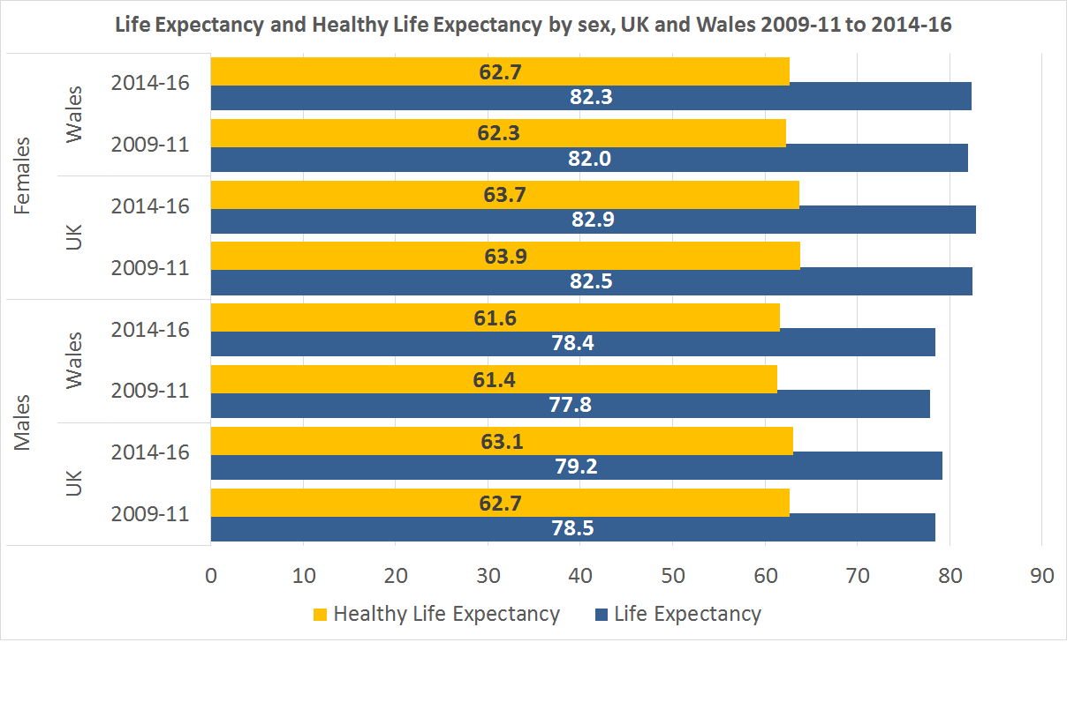
Notes:
This chart compares the change in healthy life expectancy and life expectancy in Wales compared with the UK between 2009-11 and 2014-16. For females in Wales life expectancy increased by 0.3 years while healthy life expectancy grew by 0.4 years. This meant the years lived in not good health fell slightly and the proportion of life spent health increased. In the UK, the proportion of life spent healthy fell but remained above that of wales and the years lived in not good health grew but still remained lower than in Wales.
For males, although healthy life expectancy increased, life expectancy increased much faster, meaning the proportion of life spent healthy contracted and the years lived in not good health increased. This also occurred in the UK, although the proportion of life spent healthy was higher than in Wales and years lived in not good health remained lower than in Wales.

Slide 37
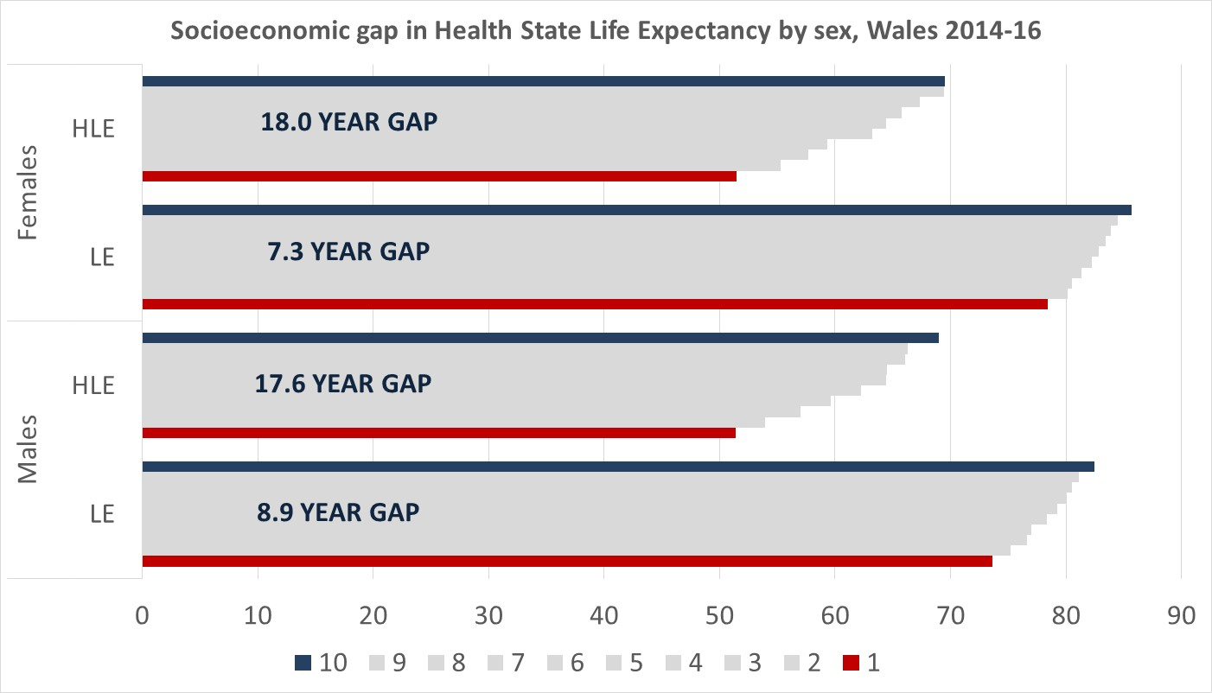
Notes:
While life expectancy and healthy life expectancy for wales as a whole has increased, large gaps in these measures were present in 2014-16 between the least and most deprived parts of Wales. While females in the least deprived areas were living to age 85.7 years compared to 78.4 years in the most deprived areas, a gap of 7.3 years and the gradient steepening most between decile 1 and decile 2. For healthy life expectancy the gap is substantially greater, ranging from 69.5 years in decile 10 reducing to 51.5 years in decile 1, an 18 year gap. Females living in decile 1 areas were living less than two-thirds of their shorter lives in good health, while in decile 10 it exceeded four-fifths.
For males, the life expectancy gap was even higher at 8.9 years, although for healthy life expectancy, the gap was somewhat lower at 17.6 years. A similar differential in the proportion of life spent healthy was also present.

Slide 38
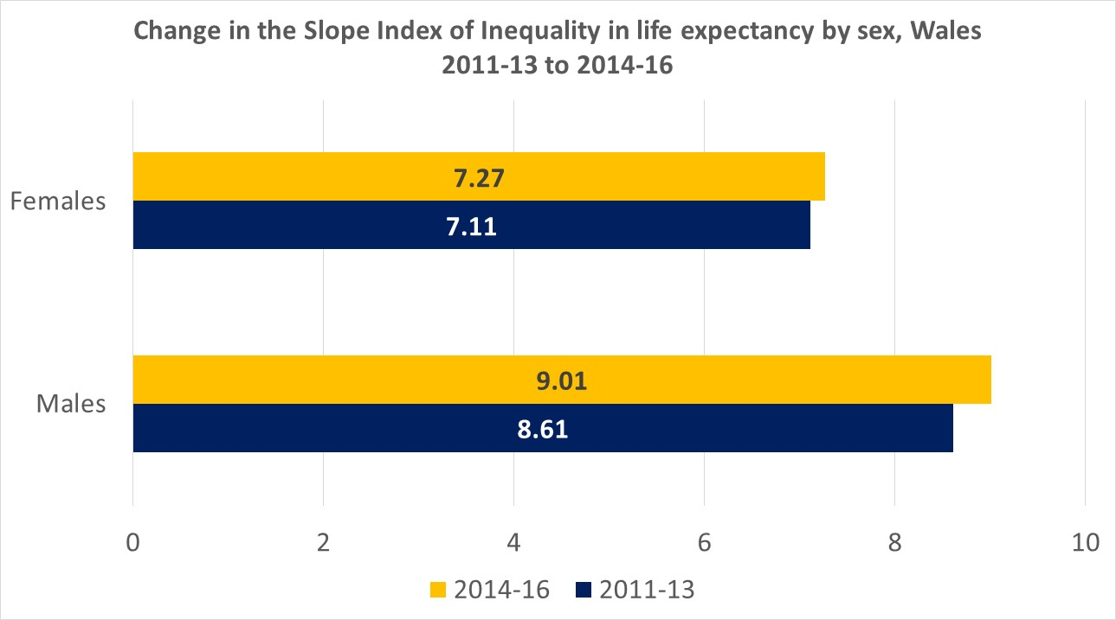
Notes:
The gap in in life expectancy between the most and least deprived males and females has grown since 2011-13. For males it now stands in excess of 9 years while for females it’s 7.3 years as measured by the slope index of inequality.

Slide 39
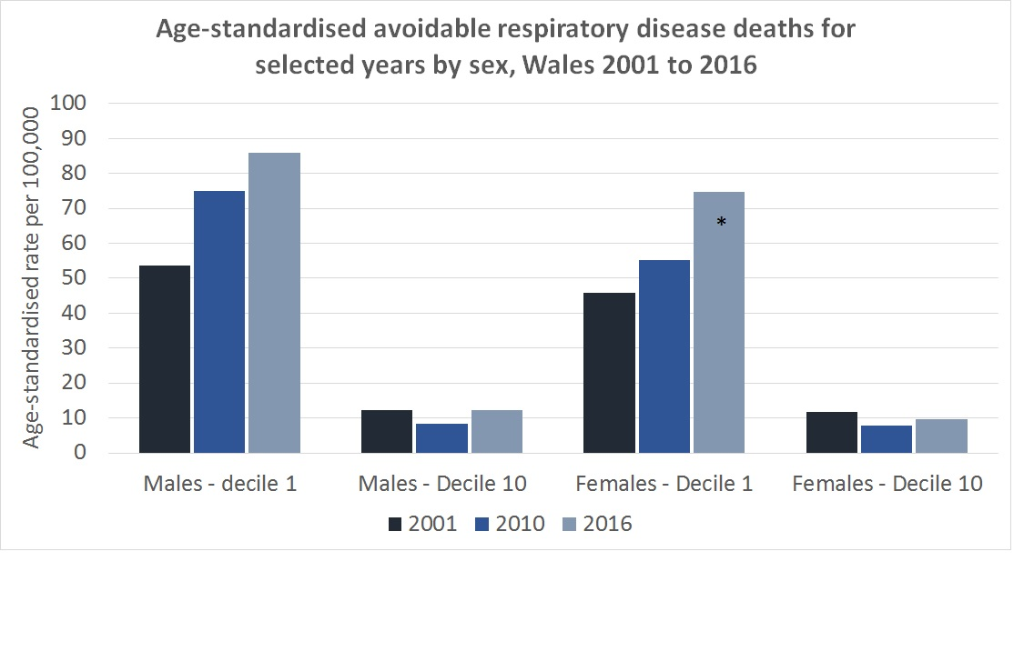

Slide 40
Upcoming publications
Excess Winter Mortality in England and Wales 16/17 final, 17/18 provisional (Nov 2018)
Health State Life Expectancy for local areas of the UK 2015-17 (Dec 2018)
Avoidable Mortality in UK and sub-national and health areas of England and Wales 2017 (Feb 2019)
Socioeconomic inequality in avoidable mortality, England and Wales 2017 (Mar 2019)
Socioeconomic inequality in health state life expectancy, England and Wales 2015-17 (Mar 2019)
Quarterly mortality surveillance Jul-Sept 2018 (Dec 2018)

Slide 41
Questions?
To contact us:
Matthew.Peet@ons.gov.uk
Chris.White@ons.gov.uk
mortality@ons.gov.uk

Slide 42
Presentation 2
Lynda Fenton, Health Scotland
Julie Ramsay, National Records for Scotland

Slide 43
Scottish mortality trends
Mortality trends workshop, Edinburgh, 13th November 2018
Julie Ramsay and Maria Kaye, National Records for Scotland
Lynda Fenton, Jon Minton and Gerry McCartney, NHS Health Scotland

Slide 44
Overview
Life expectancy – trend, average annual change and international comparison
Age-standardised mortality rates – trend and segmented regression for breakpoint
Indexed age-group mortality rates
Decomposition of change in life expectancy by:
  age
  cause of death
  area deprivation index (SIMD)

Slide 45
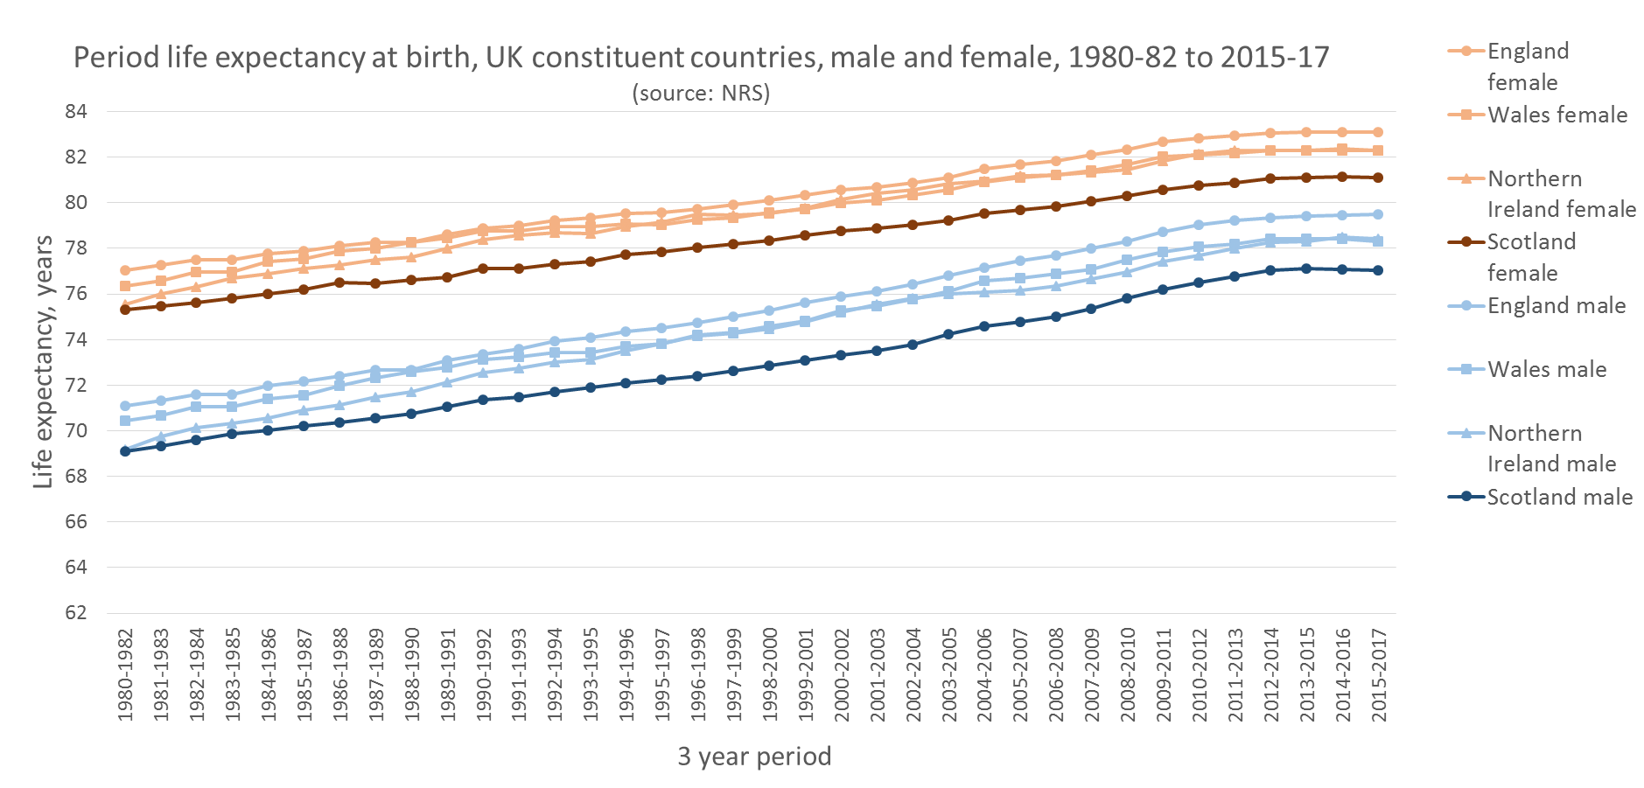
Life expectancy in Scotland

Slide 46
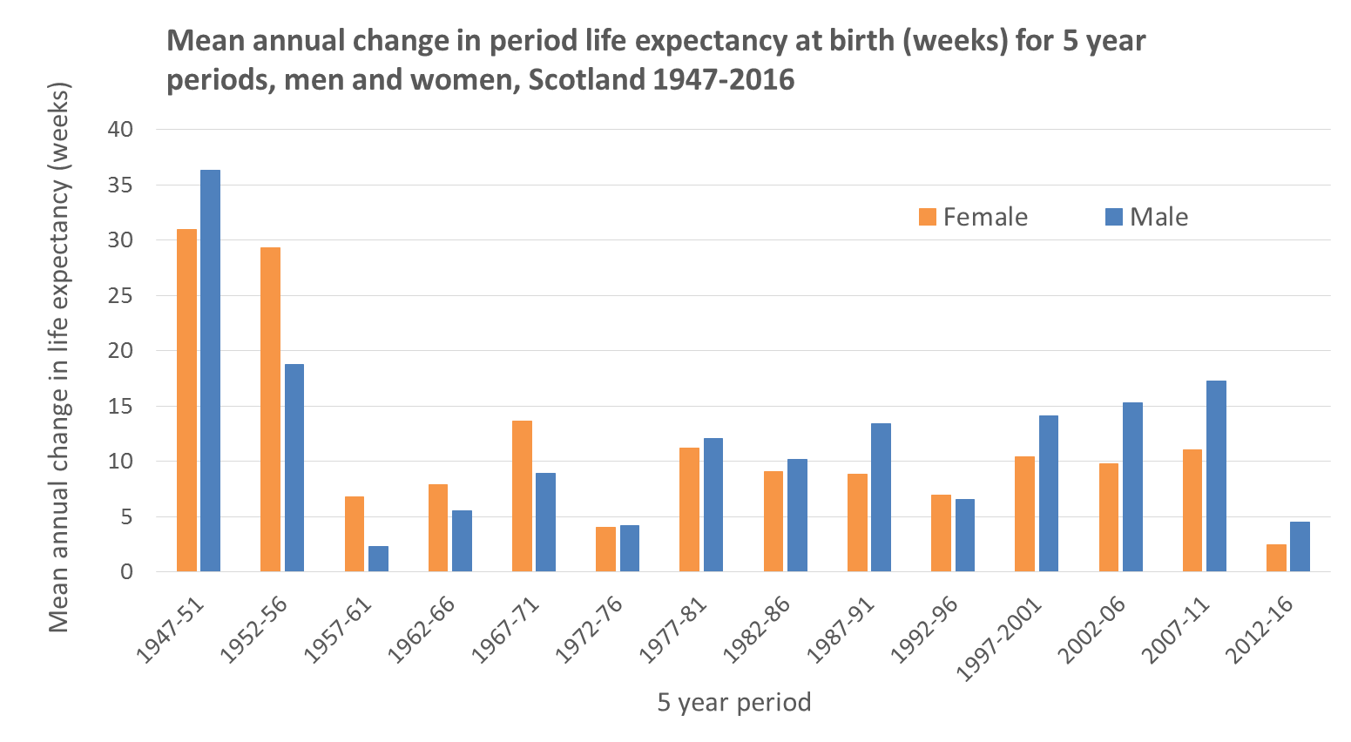
Average annual change in life expectancy - Scotland
Source: Human Mortality Database, single year life expectancy estimates, Scotland to 2016
Notes:
In 2012-2016 the average annual change in life expectancy in Scotland was +2.5 weeks for women and +4.4 weeks for men.
For women this is smallest gain in life expectancy for any of these periods since 1947
For men there were two post-war periods with smaller gains: 1957-61 and 1972-76
Adoption of rolling periods for comparison identifies similar periods :
Women: 1972
Men: 1961, 1962, 1963, 1965, 1969, 1972, 1973, 1976

Slide 47
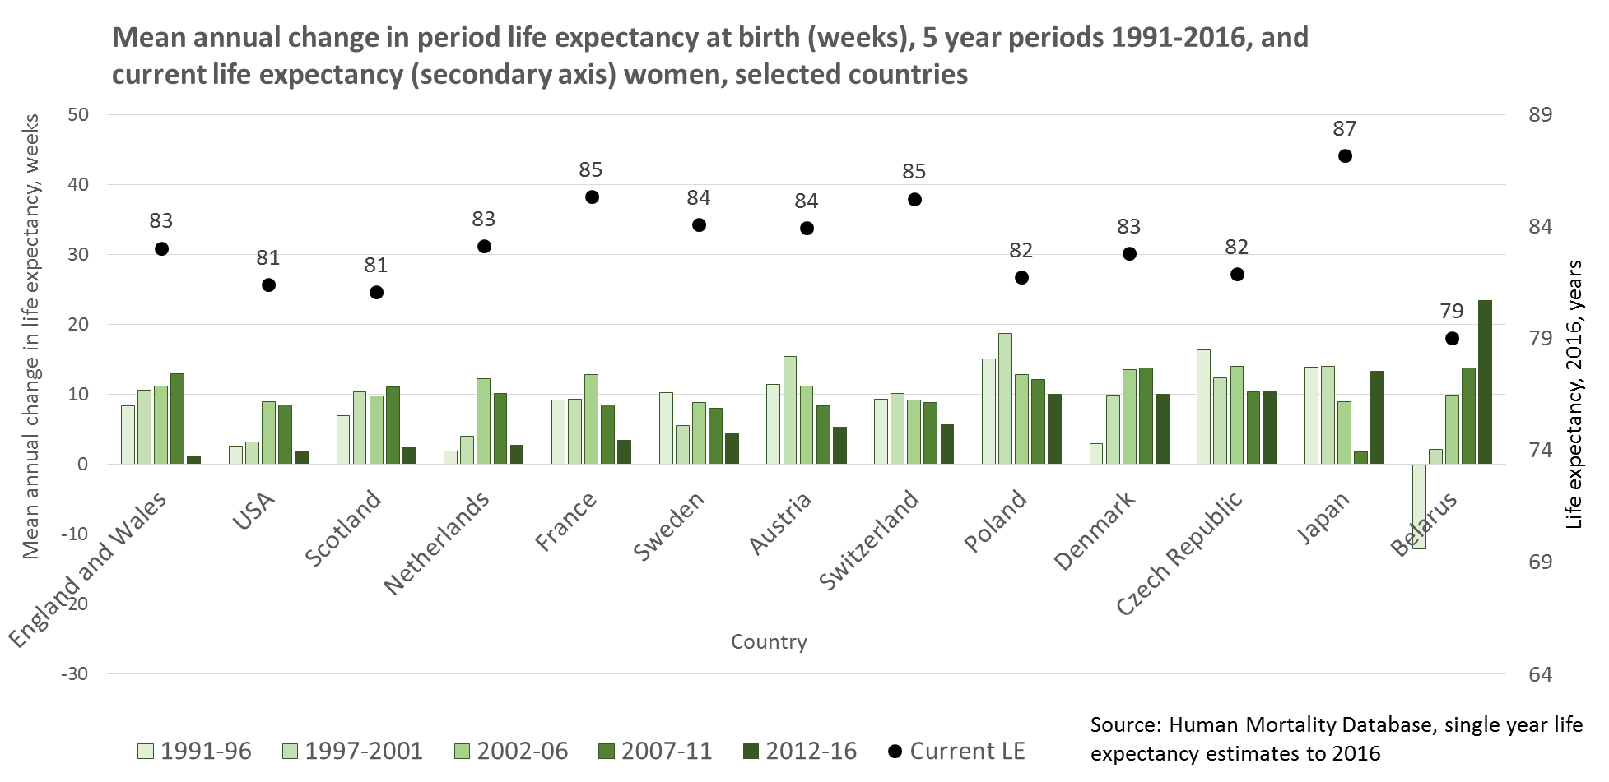
International comparison: women
Notes:
Data source: Human Mortality Database (1x1 year life expectancy) https://www.mortality.org/
Mean annual change in period life expectancy at birth for 5 year periods to 2016
12 countries for international comparison selected on basis of data availability for period 1991-2016, and population ≥ 2 million:
USA, England & Wales, Netherlands, Sweden, France, Austria, Switzerland, Denmark, Poland, Czech Republic, Japan, Belarus.
The majority of countries had smaller average gains in life expectancy in 2012-2016 compared with the preceding period, but this was not universal in occurrence or scale.
Of thirteen countries analysed, only the USA and England & Wales have seen smaller recent gains than Scotland.
A number of countries with greater life expectancy are maintaining greater average annual improvements.

Slide 48
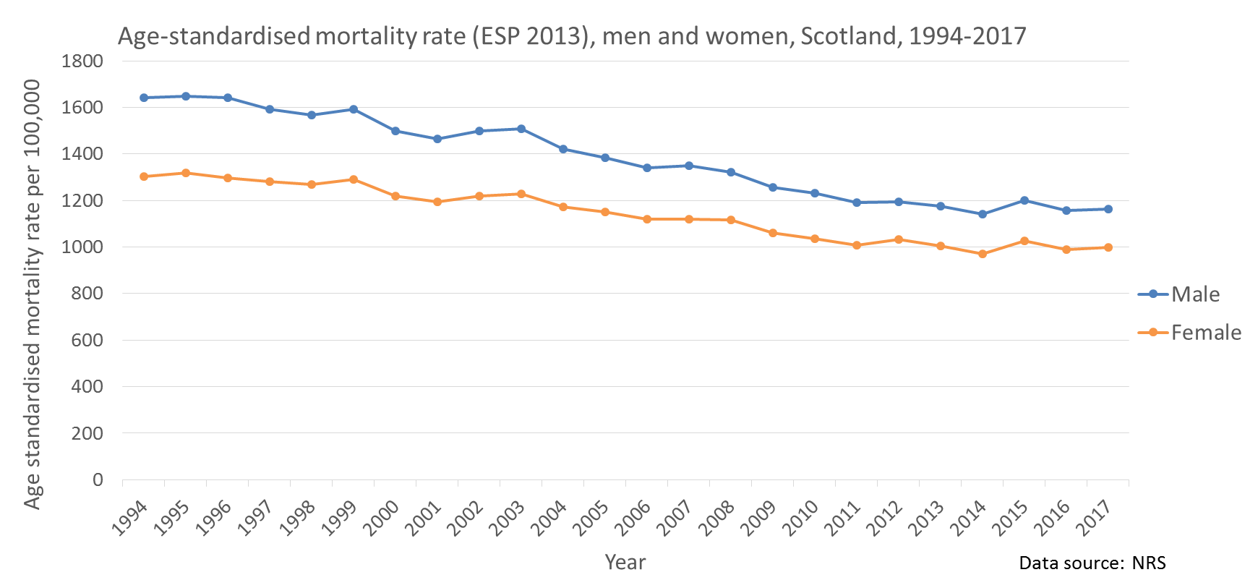
Age standardised mortality rates

Slide 49
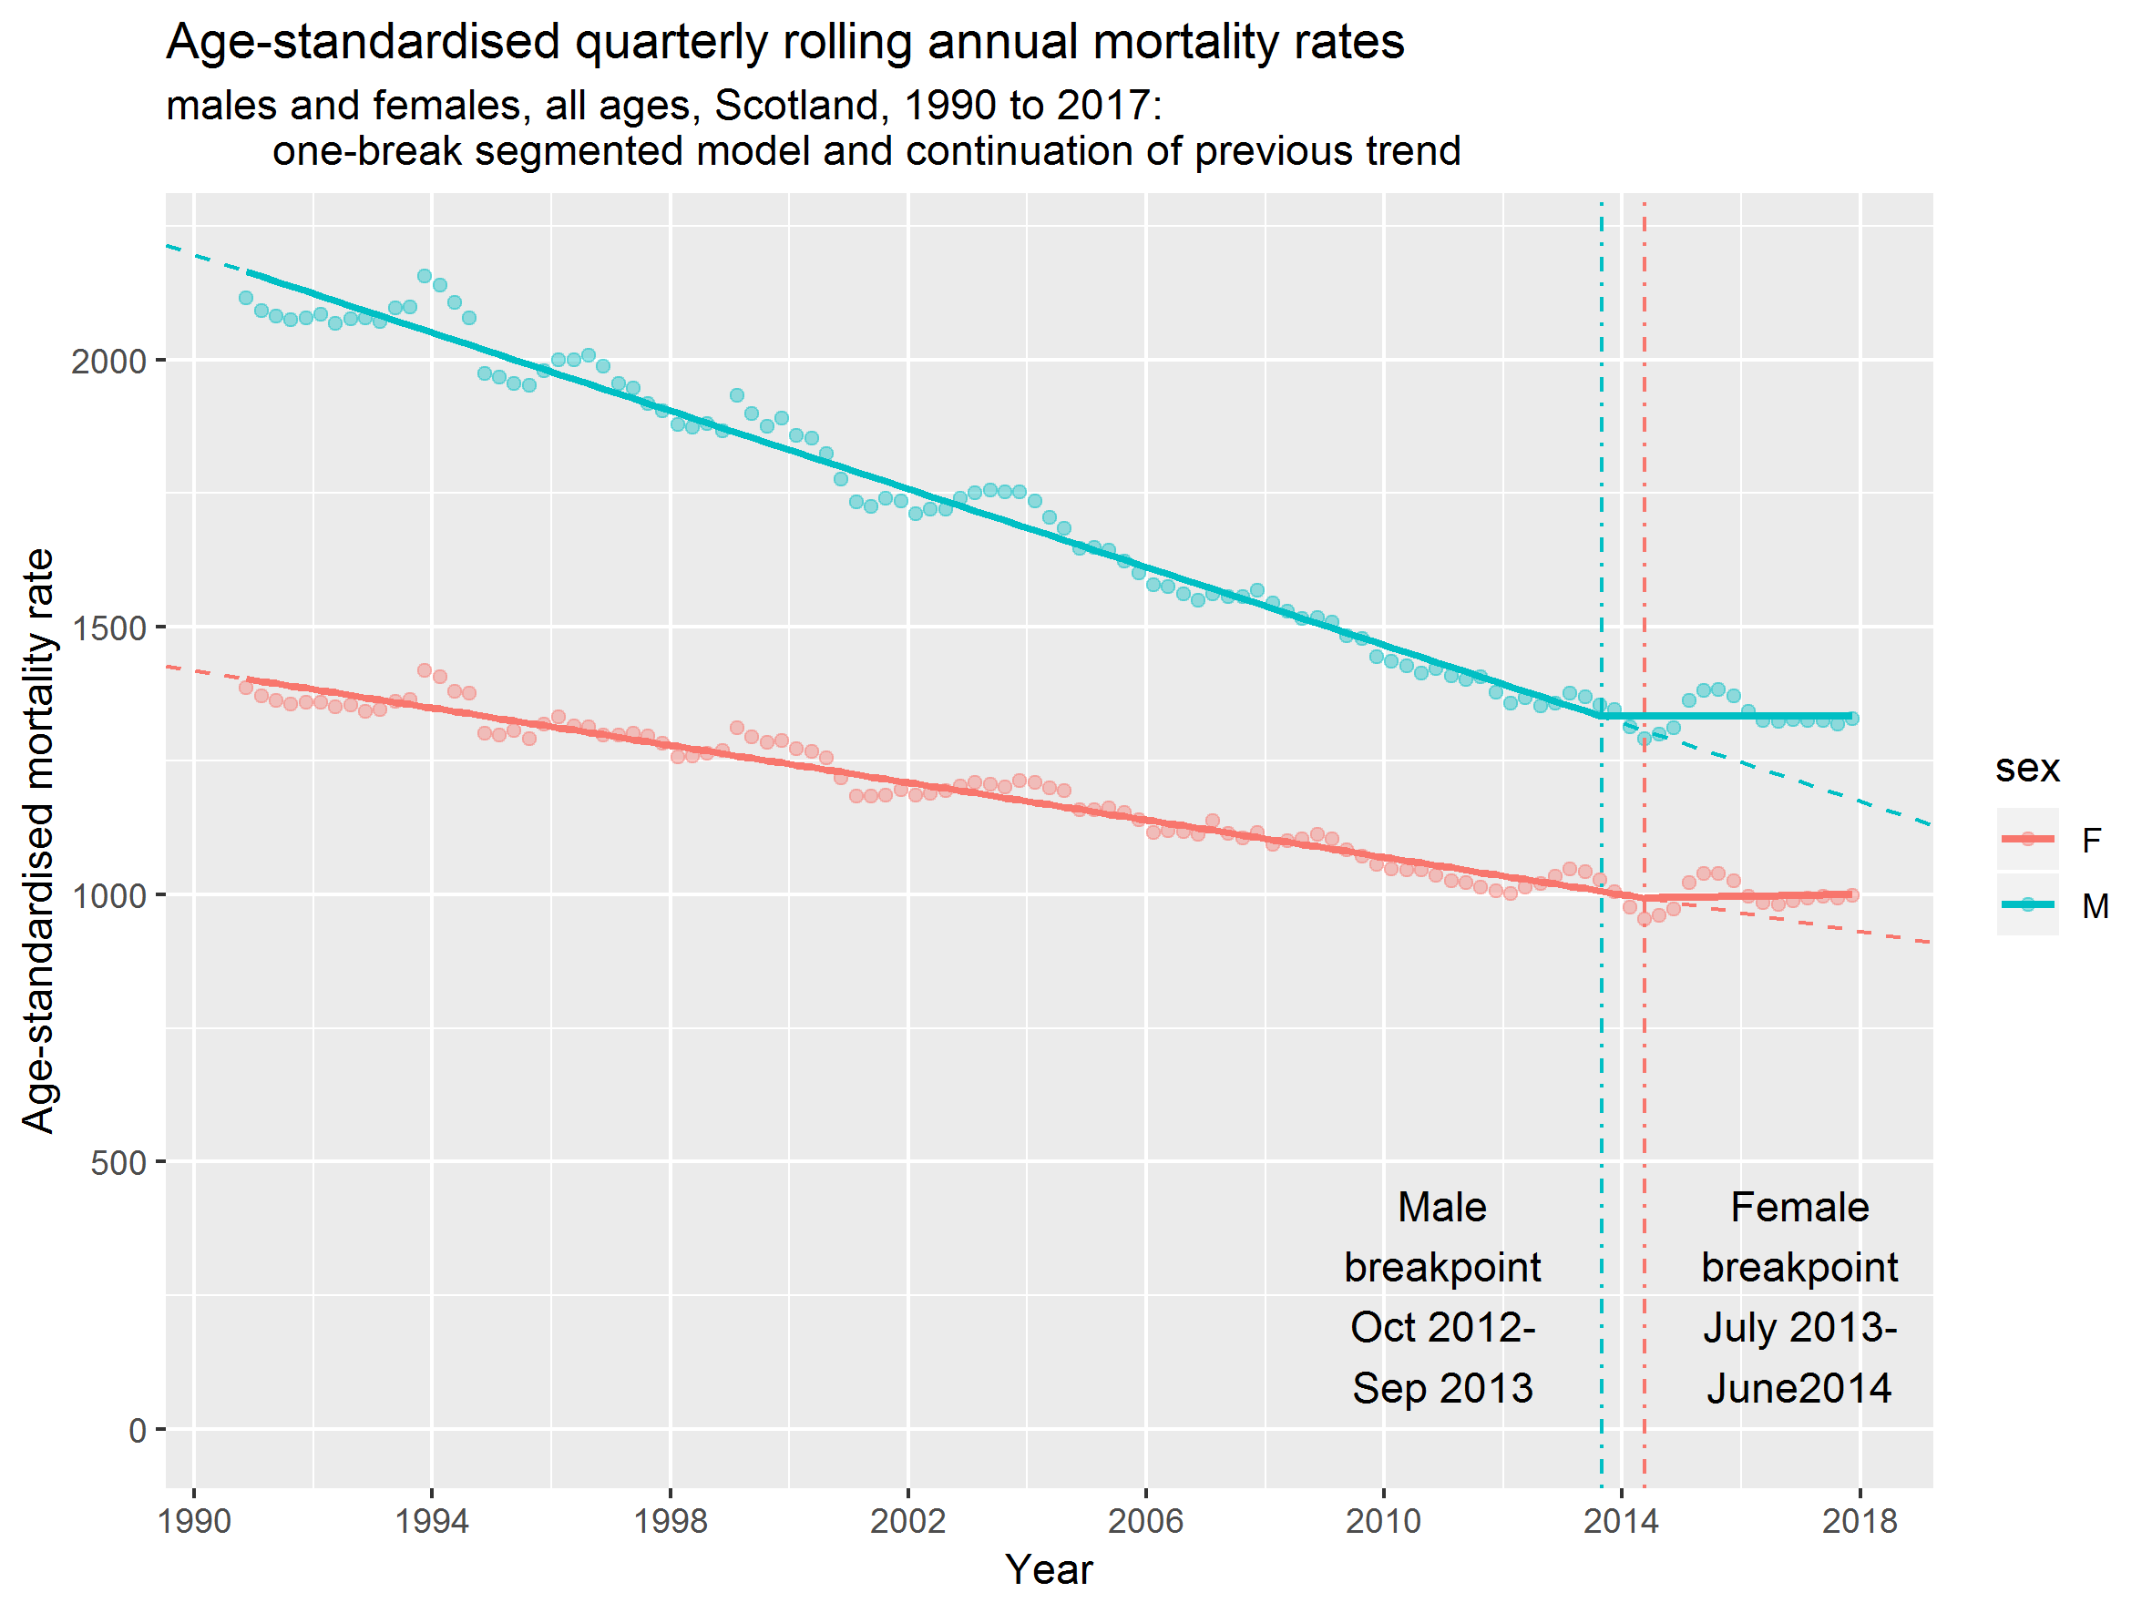
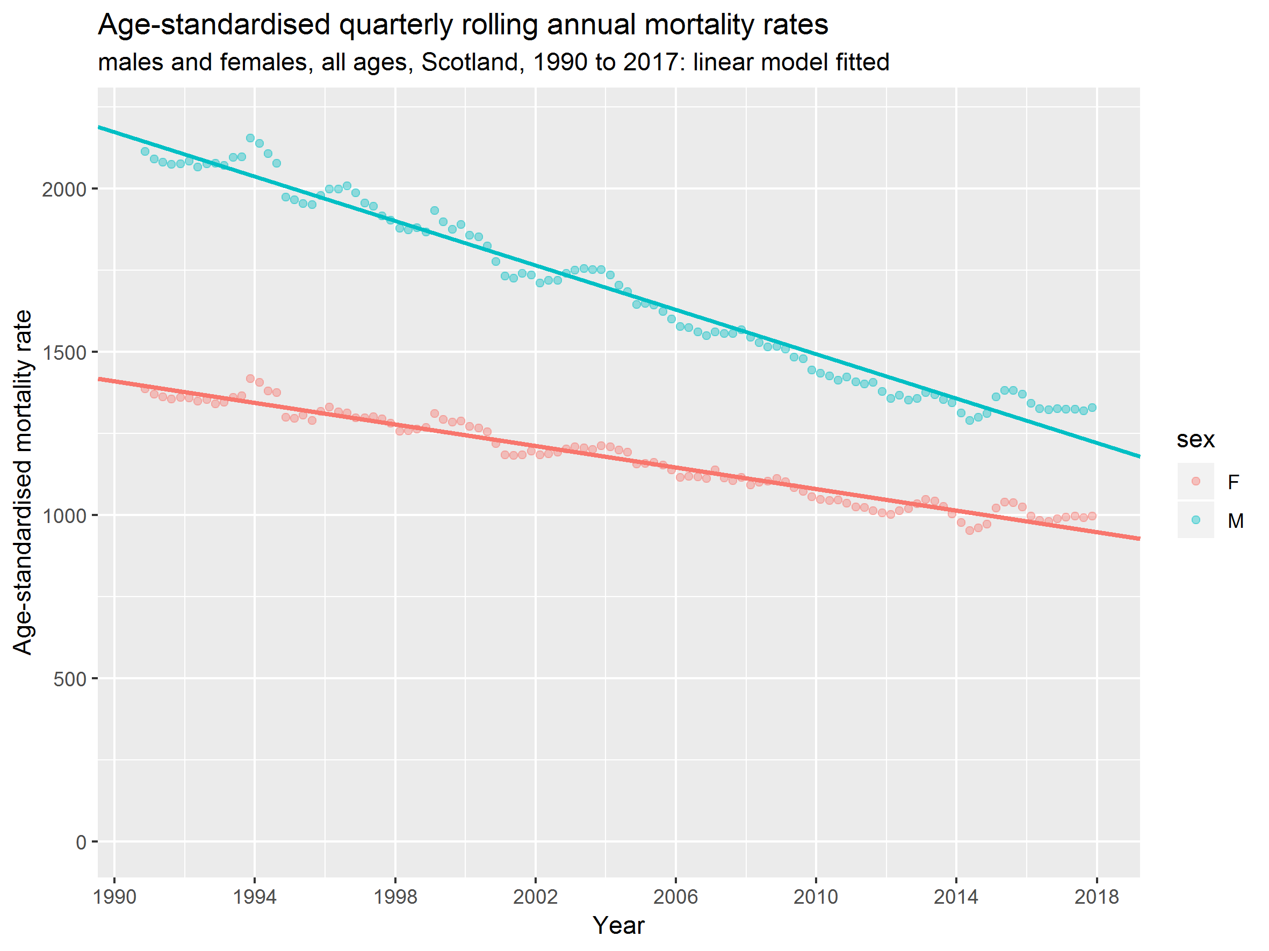
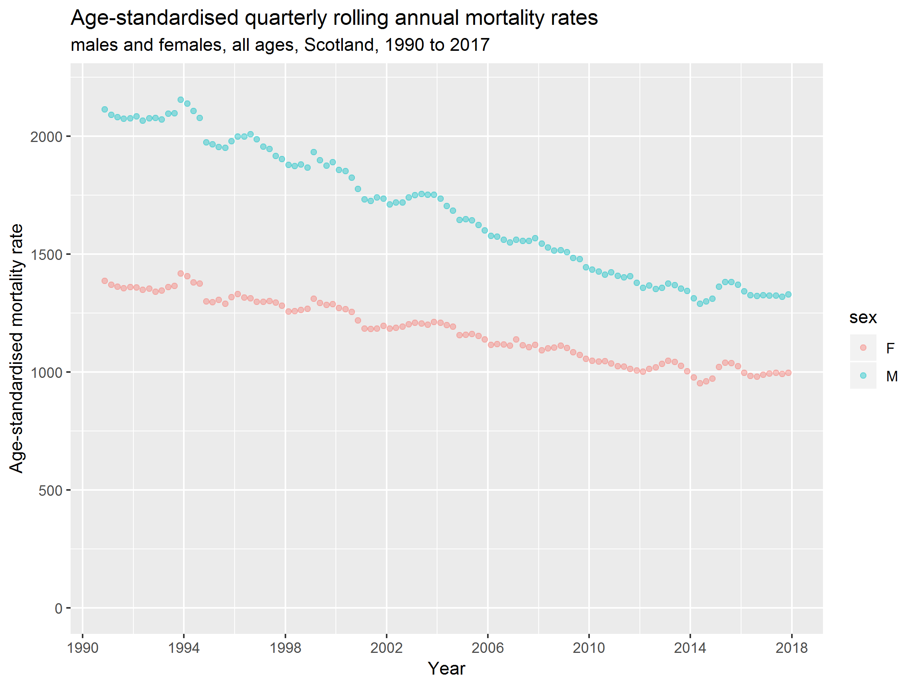
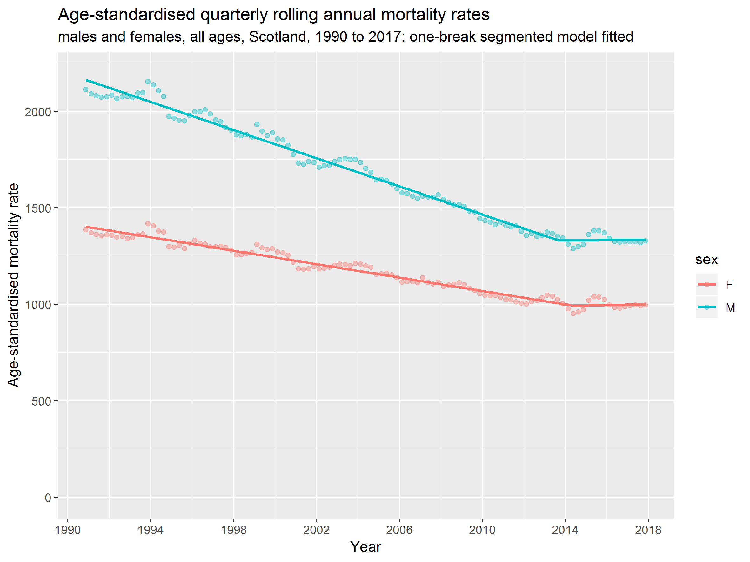
Segmented regression results
Notes:
Replication of ONS-described approach

Slide 50
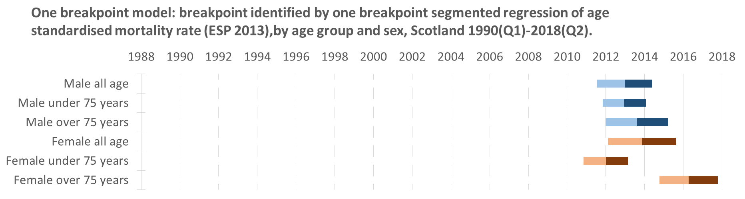
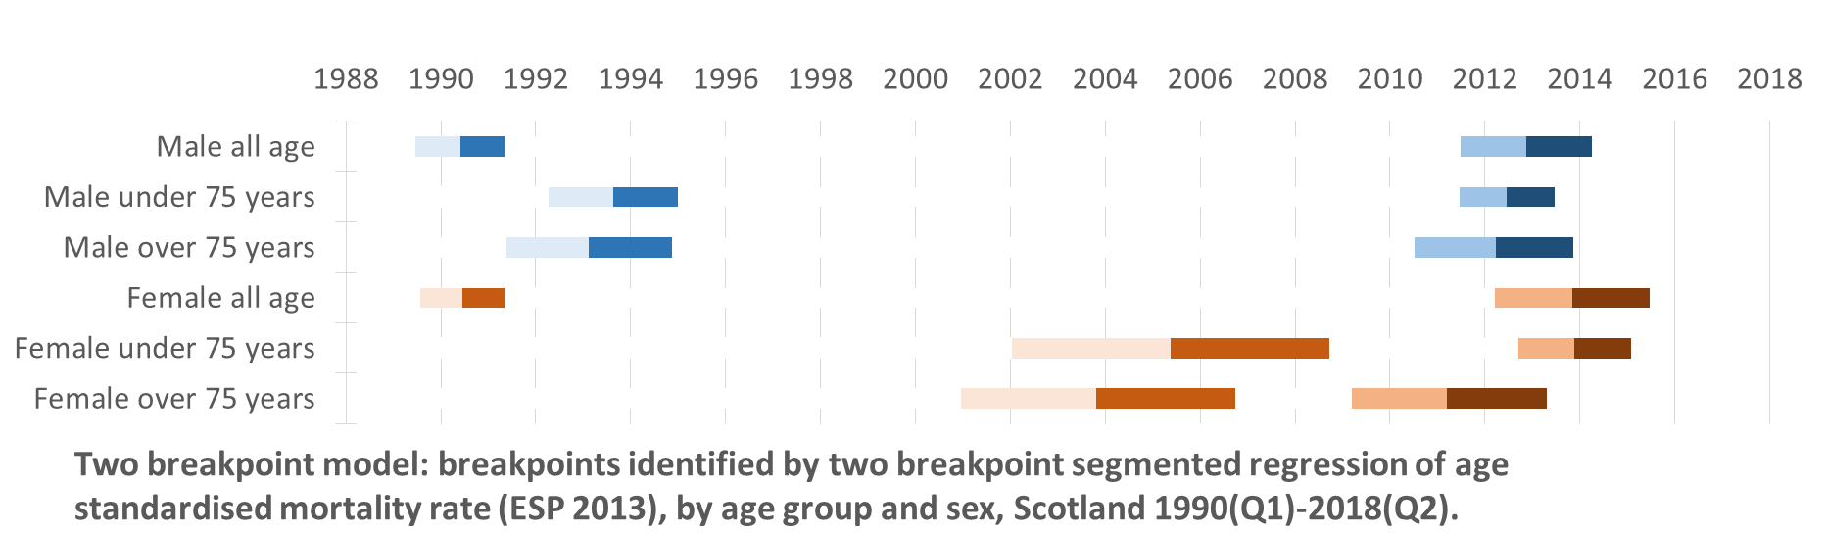

Segmented regression results
Midpoint of breakpoint year
95% confidence interval
Notes:
One break mode – compare to England:
All age men and women, and women U75 all similar to England – 1-3 quarters later, with overlapping 95% confidence intervals.
75+ men (Eng = Jul 2011-Jun 2012) 1.5 years earlier in England, overlapping CI
U75 men (Eng = Apr 2009-Mar 2010) 3 years earlier in England, no overlap
U75 women 1998 breakpoint in England

Slide 51
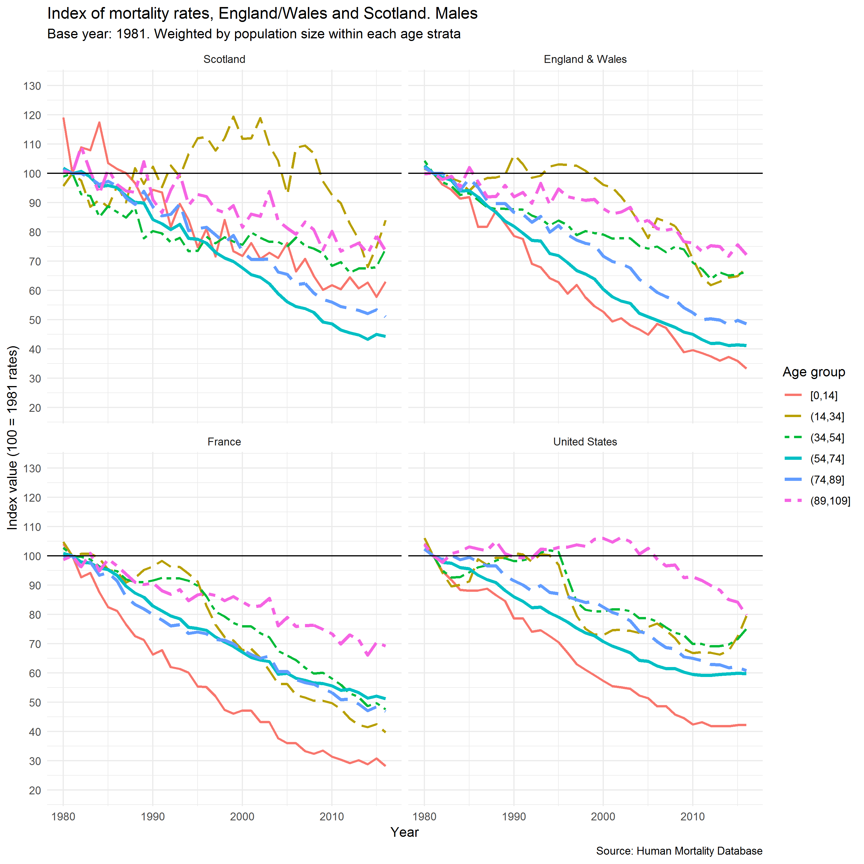
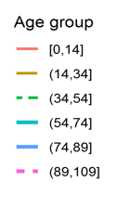
Indexed age-group mortality rates – male
1981-2016
1980
1990
2000
2010

Slide 52
Summary of findings part 1
The recent stalling of life expectancy is marked in scale
Whilst a number of countries have experience reduced gains in life expectancy, these are not uniform in scale or occurrence.
A significant change in the trend of mortality rates of men and women occurred within the period 2011-2014
Age-group mortality rates show stalling of improvements among those aged 55-89 years. Patterns in younger age groups concerning in Scotland and vary more between countries.

Slide 53
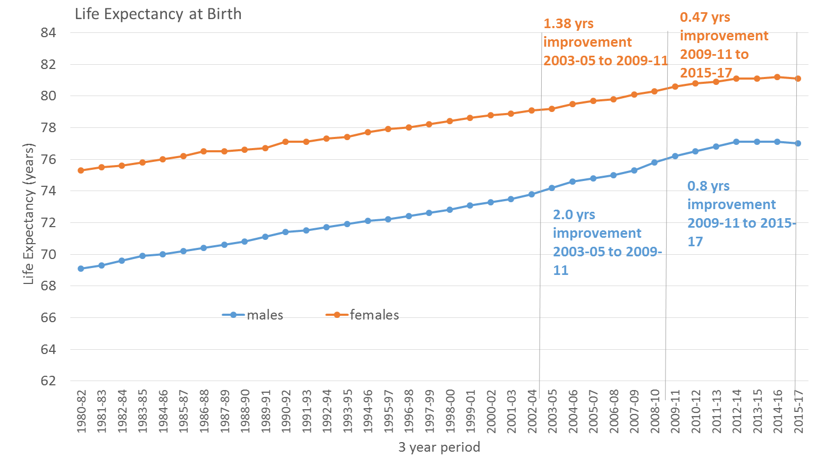
Life expectancy at birth - Scotland

Slide 54
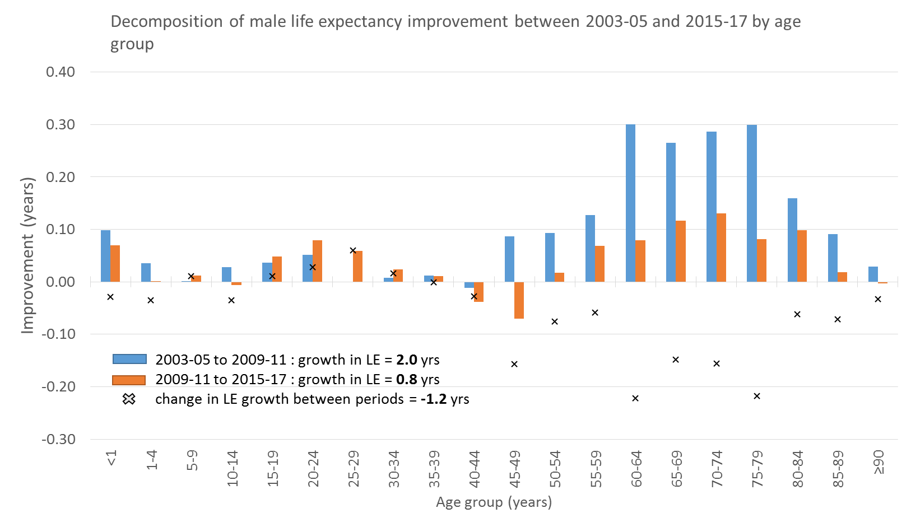
Life expectancy changes: age, men
Much smaller improvement in 60-79 yr olds (from 1.15 yrs to 0.41 yrs)
Negative impact of 40-49 yr olds in later period (from +0.08 yrs to -0.11 yrs)
Bigger improvement in 15-34 yr olds in later period (from 0.1 yrs to 0.21yrs)

Slide 55
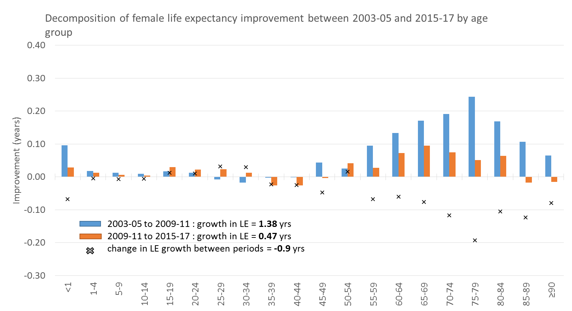
Life expectancy changes: age, women
Much smaller improvement in 65-84 yr olds (from 0.78 yrs to 0.28 yrs)
Bigger improvement in 15-34 yr olds in later period (from 0.0 yrs to 0.09yrs)
Negative impact of 35-49 yr olds in later period (from +0.04 yrs to -0.06 yrs)
Negative impact of 85+ yr olds (from +0.17 to -0.03 yrs)

Slide 56
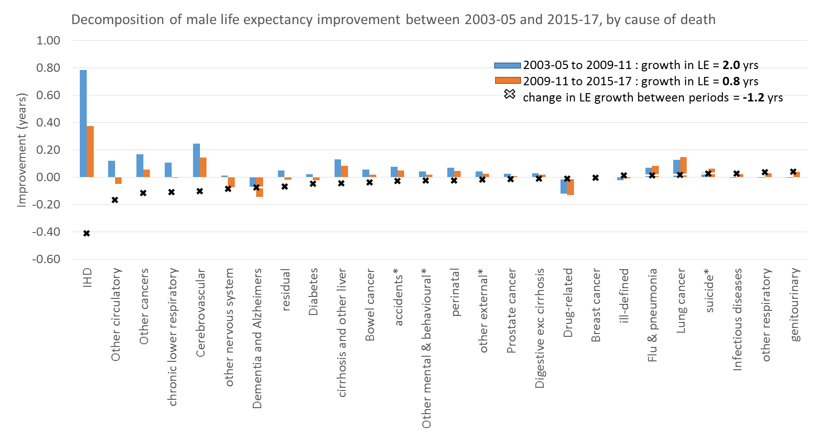
Life expectancy changes: cause of death, men

Slide 57
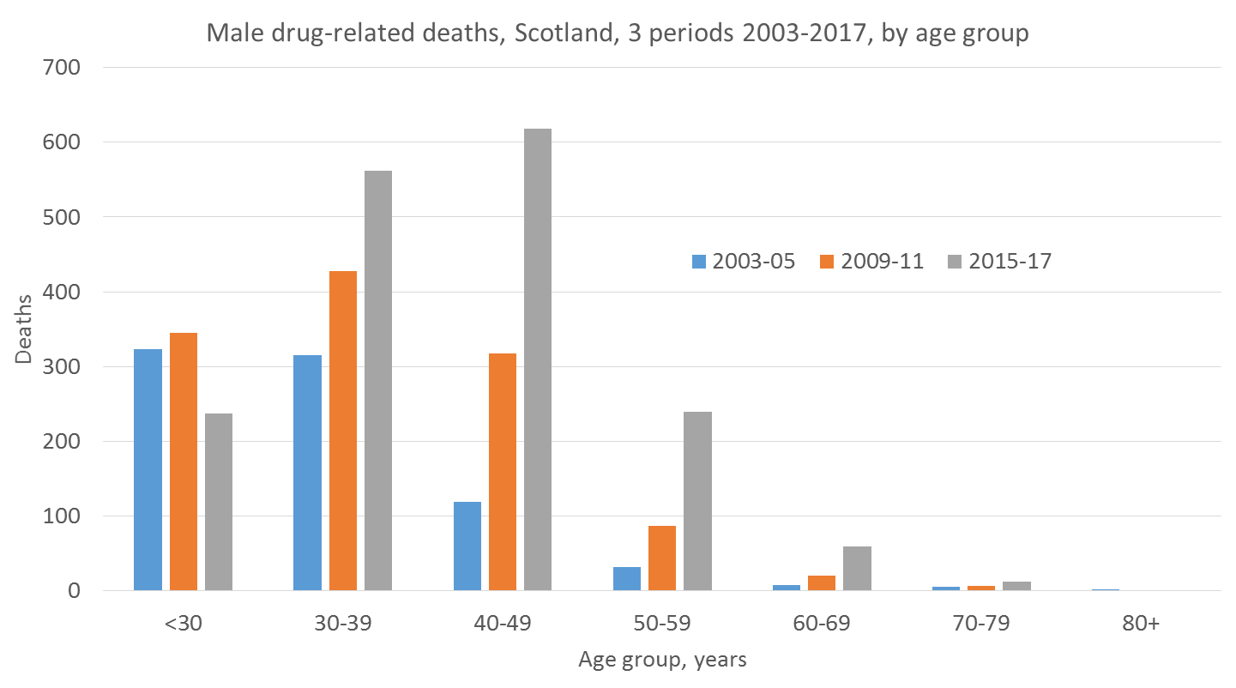
Number of drug-related deaths in each period, by age, male

Slide 58
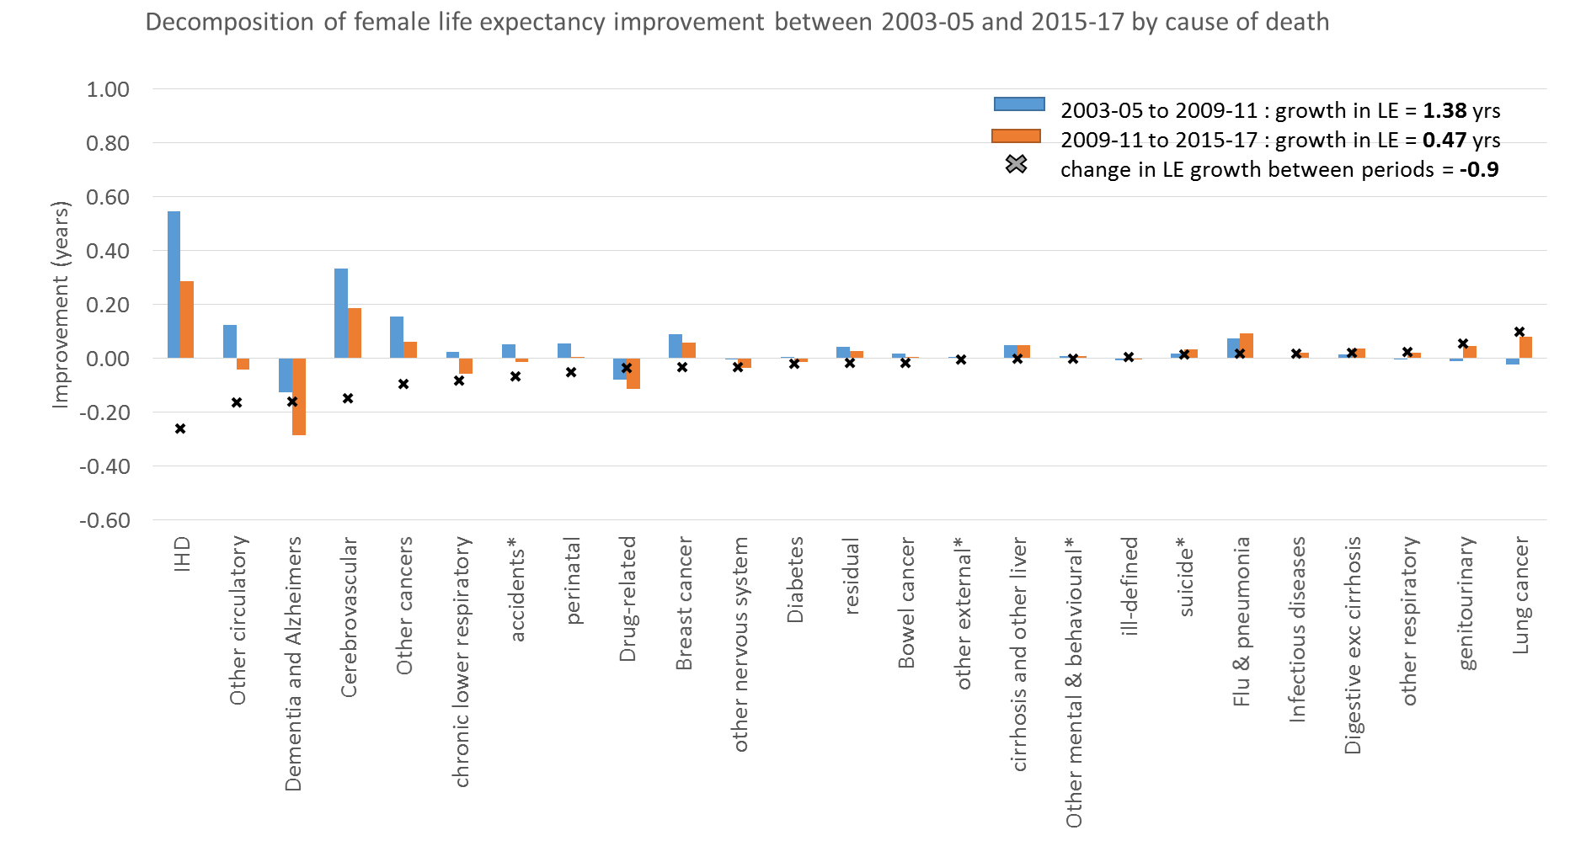
Composition of life expectancy changes: cause of death, women

Slide 59
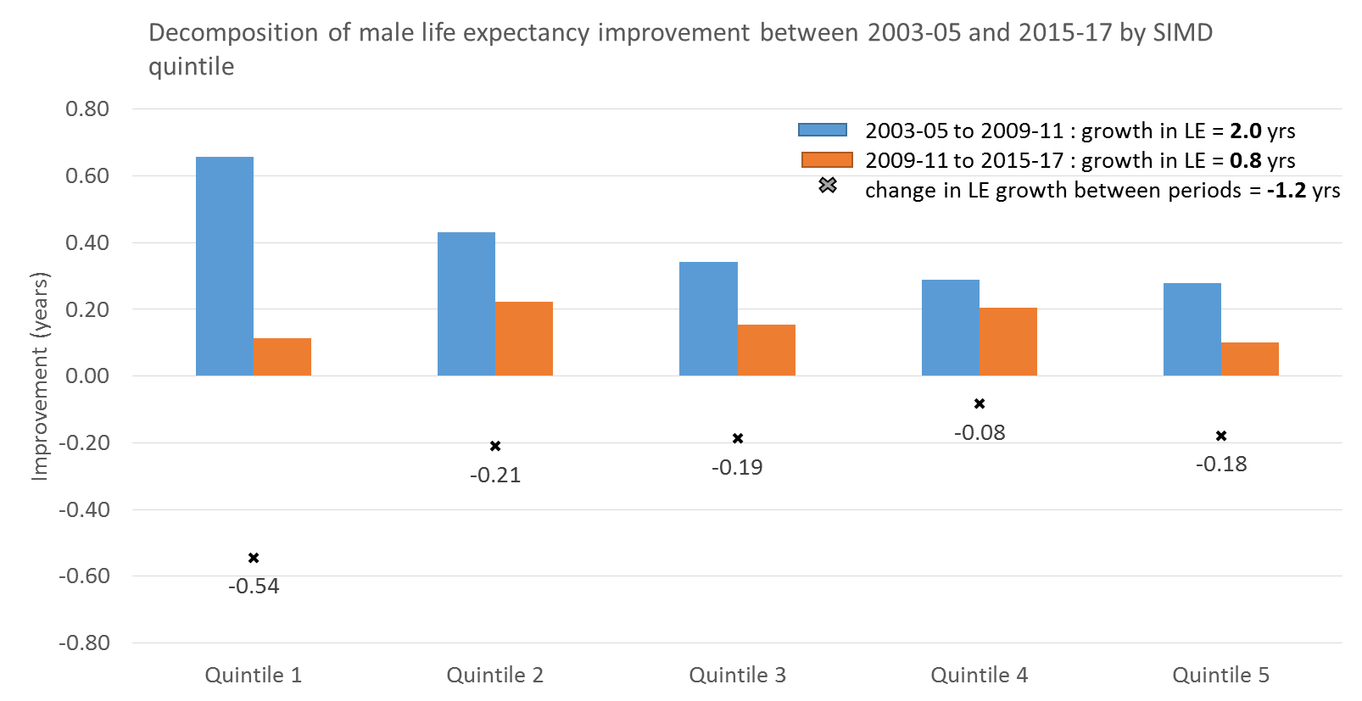
Life expectancy changes: area deprivation - male
Most deprived
Least deprived

Slide 60
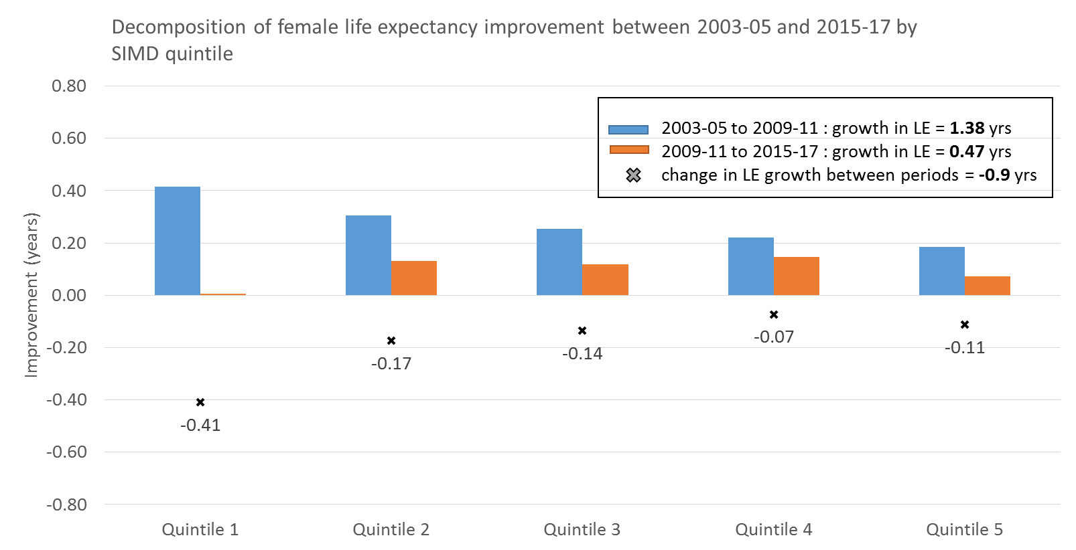
Life expectancy changes: area deprivation - female
Most deprived
Least deprived

Slide 61
Summary
Older age groups (60-85) driving the slow-down in LE growth
Slight improvements for younger age groups (15-35)
Concerning changes in 35/40-49 yr olds – negative impact on LE growth
Ischaemic heart disease main impact on slow-down for males and females
Other circulatory diseases, other cancers and chronic lower respiratory diseases also having an impact for males
Dementia and Alzheimer’s greater impact for females
Surprisingly low impact of drug-related deaths, particularly for males
Most deprived quintile driving the slow-down for males and females but caveats around measurement of this – more analysis needed

Slide 62
Ongoing descriptive work
Deprivation
  refinement of SIMD decomposition work to account for population changes
  exploration of further analytical approaches, including other measures of socio-economic position
Time periods
  determination of most appropriate time periods for comparison, and refinement of decomposition as required
Seasonality
  contribution of seasonal patterns and events to overall mortality trends

Slide 63
Acknowledgements
Chris White and team, Office for National Statistics

Slide 64
Supplemental slides
Life expectancy international comparison - male
Age-specific mortality rates – female
Number of deaths by calendar month 1975-2017
Number of deaths by urban-rural classification 1975-2017

Slide 65
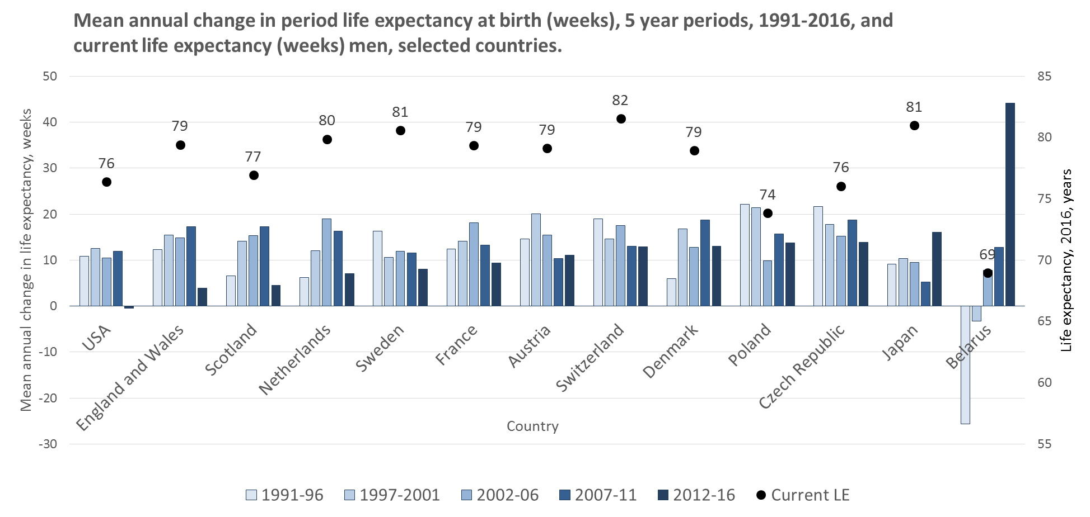
International comparison: men

Slide 66
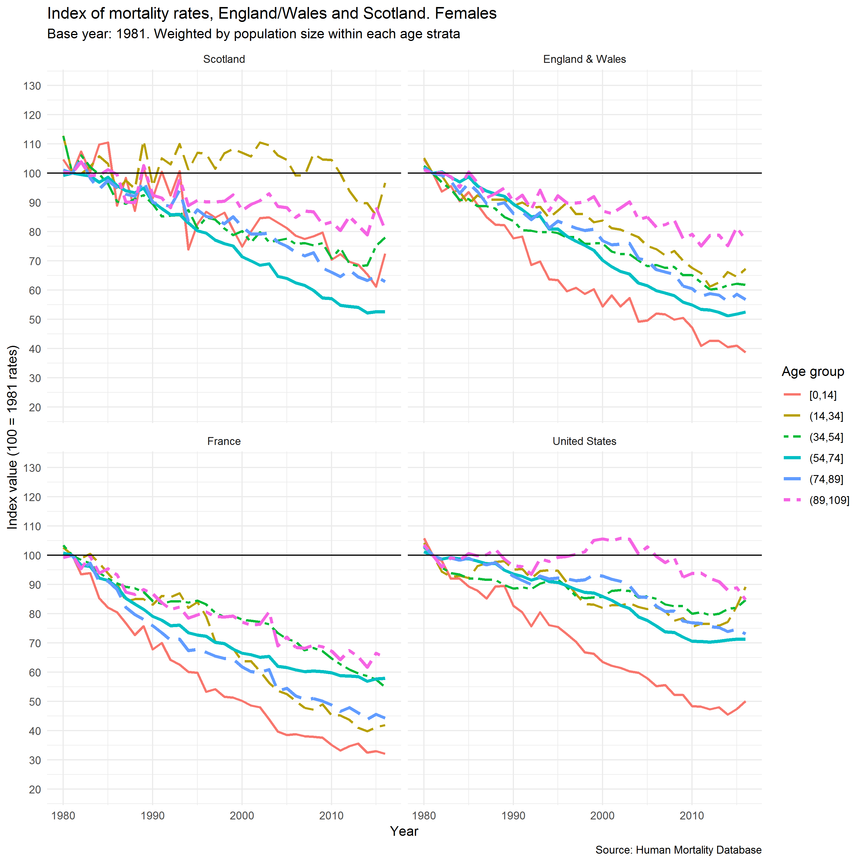
Indexed age- group mortality rates – females
1981-2016

Slide 67
Presentation 3
Mike Murphy
London School of Economics

Slide 68

Short-term fluctuations and long-term trends in recent years
Mike Murphy
Support for his work by The Health Foundation is gratefully acknowledged

Slide 69
The 2015 “spike” in long-term context
Significant decreases in life expectancy occurred simultaneously in many high income countries, usually in 2015. This universal spike in mortality has often been attributed to … flu … healthcare systems … were unable to cope with this unexpected challenge, resulting in the first reductions in longevity for decades … and might signal more profound problems ... discontinuities in secular trends can lead to prolonged health crises—they are warning signs of fundamental and longstanding societal and health problems.”
Jasilionis, BMJ, 2018

Slide 70
The Context: the 2015 “spike”
Compared with the yearly average for 2010-14, there were about 30,000 more deaths in England in 2015.
…
We tested the impact of recent population changes by applying the death rates for 2010-14 to the population in 2015. Around two-thirds of the excess deaths in women in 2015, and all of the excess in men, could be explained by changes in the population size and age structure.
This means there were still almost 5,000 more female deaths than expected that could not be accounted for by population change alone. [about 1% excess]
Compared with 2014, in 2015 female life expectancy at birth fell in 23 of the 28 countries in the EU and male life expectancy at birth fell in 16 EU countries.
PHE Blog What’s happening with mortality rates in England? July 2017 John Newton, Allan Baker, Justine Fitzpatrick and Faith Ege.

Slide 71
Explaining the 2015 Spike
“Early analysis shows the largest rise in the number of deaths in England and Wales in over a decade was a result of an increase in dementia and Alzheimer’s related deaths and respiratory diseases (including flu) among older people.
An increase in deaths will generally lead to a decrease in life expectancy that year, but we have seen these annual fluctuations before and the overall trend has remained positive”
ONS
“what is being observed cannot easily be attributed to influenza … the evidence points to a major failure of the health system, possibly exacerbated by failings in social care”
Hiam et al

Slide 72
Research questions
What effect does an event such as the 2015 “spike” have on underlying long-term-trends?
Are short-term and long-term factors independent or linked?

Slide 73
Separating long- and short-term factors
Standard time series approach is to disaggregate into trend, seasonal & irregular (i.e. residual)

Slide 74
Monthly deaths United Kingdom Distinguishing Short & Long-term factors:

Slide 75
Annual deaths United Kingdom Distinguishing Short & Long-term factors:

Slide 76
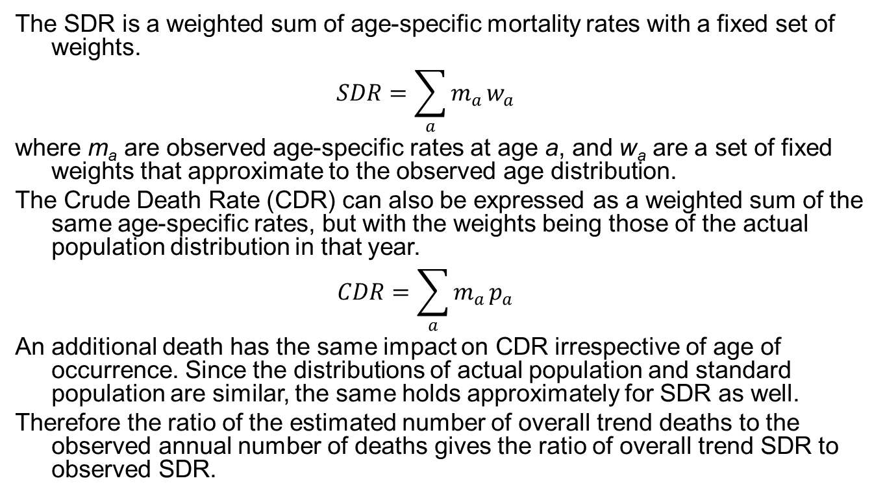
Decomposition of SDRs
The SDR is a weighted sum of age-specific mortality rates with a fixed set of weights.
$$SDR=\sum_{a}{m_{a}}w_{a}$$
where m_{a} are observed age-specific rates at age a, and w_{a} are a set of fixed weights that approximate to the observed age distribution.
The Crude Death Rate (CDR) can also be expressed as a weighted sum of the same age-specific rates, but with the weights being those of the actual population distribution in that year.
$$CDR=\sum_{a}{m_{a}}p_{a}$$
An additional death has the same impact on CDR irrespective of age of occurrence. Since the distributions of actual population and standard population are similar, the same holds approximately for SDR as well.
Therefore the ratio of the estimated number of overall trend deaths to the observed annual number of deaths gives the ratio of overall trend SDR to observed SDR.

Slide 77
UK SDR Trends original and adjusted for annual fluctuations

Slide 78
The adjusted values show slightly attenuated trends (e.g. the elbow in 2011), and slightly less pronounced declines, but leave the main conclusion that these fluctuations add little to the direct explanation of the reductions in long-term improvement in mortality
However, the countries which appear to have recovered such as Scandinavia have been less affected (so potentially effects not just in winter)
Seasonal excess doesn’t affect long-term trends substantially, but Western Europe more affected by deterioration than Northern Europe

Slide 79
Decomposition terms
Year | Annual total (000s) | Percent
 |  | Secular trend | Seasonal excess | Residual
1990 | 641.80 | 89.45 | 11.29 | -0.73
1991 | 646.18 | 88.55 | 11.20 | 0.26
1992 | 625.14 | 91.22 | 11.59 | -2.81
1993 | 657.85 | 86.38 | 11.05 | 2.57
1994 | 625.90 | 90.44 | 11.67 | -2.11
1995 | 645.49 | 87.31 | 11.37 | 1.33
1996 | 638.90 | 87.74 | 11.52 | 0.74
1997 | 629.55 | 88.49 | 11.70 | -0.19
1998 | 627.63 | 88.12 | 11.71 | 0.18
1999 | 632.06 | 86.79 | 11.54 | 1.67
2000 | 608.37 | 89.38 | 11.85 | -1.23
2001 | 602.27 | 89.44 | 11.78 | -1.22
2002 | 606.21 | 87.99 | 11.48 | 0.53
2003 | 611.18 | 86.41 | 11.14 | 2.45
2004 | 583.08 | 89.68 | 11.42 | -1.10
2005 | 582.96 | 88.85 | 11.17 | -0.02
2006 | 572.22 | 89.72 | 11.17 | -0.88
2007 | 574.69 | 88.64 | 10.96 | 0.40
2008 | 579.70 | 87.33 | 10.77 | 1.90
2009 | 559.62 | 90.08 | 11.13 | -1.21
2010 | 561.67 | 89.60 | 11.12 | -0.73
2011 | 552.23 | 91.26 | 11.41 | -2.67
2012 | 569.02 | 88.96 | 11.23 | -0.19
2013 | 574.95 | 88.70 | 11.30 | 0.00
2014 | 568.84 | 90.56 | 11.64 | -2.20
2015 | 601.27 | 86.71 | 11.23 | 2.06
2016 | 595.66 | 88.70 | 11.57 | -0.27
2017 | 607.17 | 88.23 | 11.58 | 0.19

Slide 80
Counterfactual scenario for UK mortality: annual deaths with Winter 2014−15 imputed
With the same approach, how different would the results have been if winter excess mortality had been low rather than high in winter 2014-15?

Slide 81
UK annual deaths with Winter 2014−15 imputed

Slide 82
UK SDR Trends adjusted for annual fluctuations, original and imputed

Slide 83
UK percentage SDR improvement, adjusted original and 2014−15 imputed

Slide 84
Distinguishing Short & Long-term factors:
The key question is what role did the 2015 mortality spike have on the persistent change in mortality improvement from around 2011.
If the 2015 spike had not occurred, the impact on long-term trend would be very small.
The counterfactual implicitly assumes that none of the “missing” deaths would have occurred in the study period, to that extent, the estimated effect is maximised.

Slide 85
Distinguishing Short & Long-term factors:
The key question is what role did the 2015 mortality spike have on the persistent change in mortality improvement from around 2011.
If the 2015 spike had not occurred, the impact on long-term trend would be very small.
The counterfactual implicitly assumes that none of the “missing” deaths would have occurred in the study period, to that extent, the estimated effect is maximised.

Slide 86
What’s happening to Excess Winter Mortality Index (%), UK 1960-2018?
Period | Mean | S.D.
1960-1968 | 31.9 | 9.2
1969-1974 | 26.0 | 7.6
1975-1980 | 22.1 | 6.1
1981-1986 | 22.4 | 3.9
1987-1992 | 18.0 | 5.6
1993-1998 | 17.4 | 6.1
1999-2004 | 18.9 | 7.0
2005-2010 | 16.6 | 4.4
2011-2018 | 16.9 | 5.6
and why isn't it increasing?

Slide 87
Distinguishing Short & Long-term factors
Evidence of slow-down recently
General long-term improvements
Substantial annual fluctuations, generally diminishing over time (early 2000s low variability)
Gender trend differences small and predictable (e.g. male:female crossover)
Patterns within UK similar (NI shows greatest differences)
Accelerating improvement since 1970s until sharp reduction around 2010

Slide 88
Presentation 5
Jim McMenamin
Health Protection Scotland

Slide 89
What contribution did influenza make to the excess mortality observed in the winter of 2017/18?
Dr Jim McMenamin
Consultant Epidemiologist
Interim Clinical Director

Slide 90
What contribution did influenza make to the excess mortality observed in the winter of 2017/18?
Dr Jim McMenamin
Consultant Epidemiologist
Interim Clinical Director

Slide 91
What am I going to cover?
Flu key points
What does flu surveillance & modelling demonstrate?
  Real time excess all cause mortality (EuroMOMO)
  Real time contribution of flu, cold weather and unmeasured confounders to excess all cause mortality (FluMOMO)
  What is the correlation between respiratory infection and excess all cause mortality?
  What does data-linkage of NRS, ISD & HPS data show?
Conclusions
Next steps?

Slide 92
Flu key points
Influenza (flu) is a viral infection that easily spreads through coughs and sneezes
In the Northern Hemisphere incidence increases in the winter as environmental conditions favour transmission & affect 5-25% of the population each season
Although must people will recover without consequence it may produce severe complications in some clinical risk group & the elderly
Prior natural infection or immunisation may reduce the rate of complications
The hospital admission & case fatality rate are related to this prior exposure/immunity
  Influenza A (H1N1) strains most likely to affect the young & working age
  Influenza A (H3N2) strains most likely to affect the elderly
  Influenza B strains most likely to affect the young and the elderly
Vaccination is targeted to those most at risk of these complications on an annual basis with Scotland leading the EU in uptake of vaccine in those 65+ years.
Effectiveness of the vaccine varies from season to season

Slide 93


Pre 2017/18 season prediction?
Severe flu season expected?
“Aussie flu” of influenza A(H3N2) in June 2017; Southern Hemisphere flu vaccine less effective than hoped for against this dominant seasonal strain
Experience replicated the same findings in UK from their 2016/17 season – particularly those >65 yrs
Same influenza A(H3N2) component contained in the vaccine pre-ordered for Northern Hemisphere
Flu viruses constantly evolving - Uncertainty of which flu strain would dominate in the 2017/18 season
This and other information fed into pre-season planning

Slide 94
HPS role?
Surveillance
Detect the start of the season
Determine peak
Determine the end of the season
Determine whether the flu viruses match strains in the vaccine
Risk Assessment, Advise, Coordinate HP Response & Managing outbreak(s)
Determine the effectiveness (or otherwise) of countermeasures
Determine the public health impact (or otherwise) of countermeasures
Communication
Describe the effectiveness (or otherwise) of countermeasures
Describe the public health impact (or otherwise) of countermeasures

Slide 95
Influenza surveillance - Scotland, 2017/18
Influenza Surveillance
ECOSS (Mainly hospital lab flu tests)
E-pharmacy Antiviral prescription
Influenza like illness (aggregate level)
Hospital
Admissions (delay of at least 1 but up to 3 months)
Molecular
Sequencing (antiviral resistance)
Mortality data (all excess deaths)
SARI ITU cases/flu deaths (boards)
NHS24
GP Sentinel Swabbing scheme (Is vaccine effective?)
Flu Vaccine
uptake
ARI outbreaks

Slide 96
Flu in the community

Slide 97
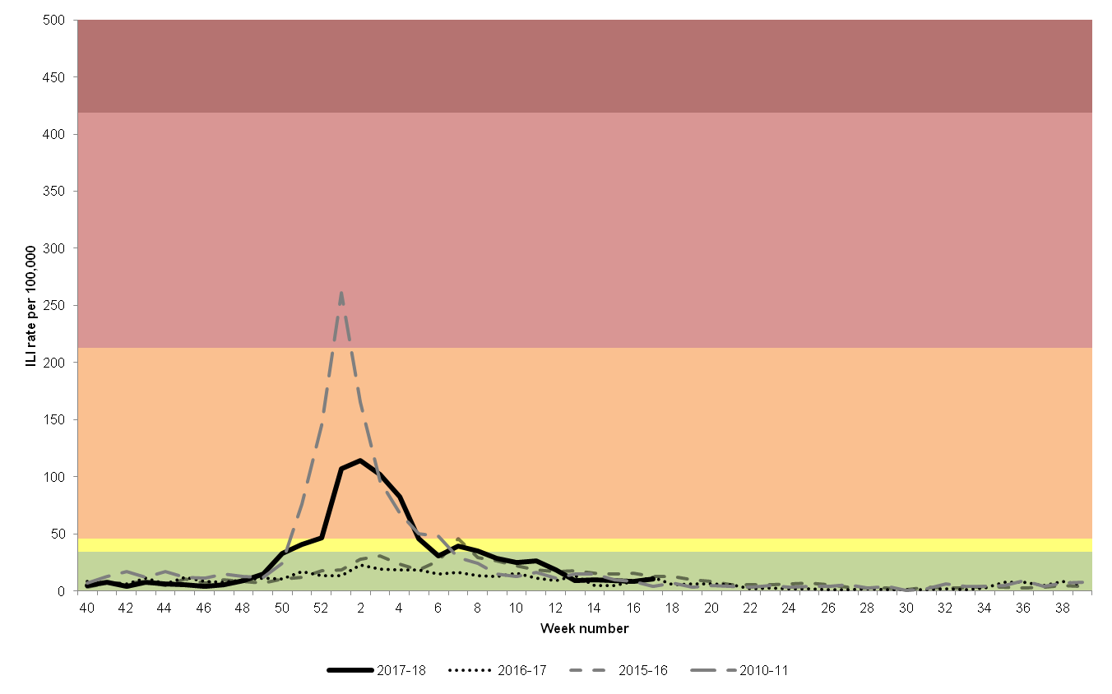
GP Influenza like illness (ILI) rates/100,000 with Moving Epidemic Method (MEM) thresholds
All ages | baseline activity | low activity | moderate activity | high activity | very high activity
2017/18 | < 34.53 | 34.53 to <45.92 | 45.92 to <212.73 | 212.73 to <418.92 | >418.92
†As year 2015 had 53 weeks, weeks 52 and 53 were added together to produce week 52 figures for 2015/16

Slide 99
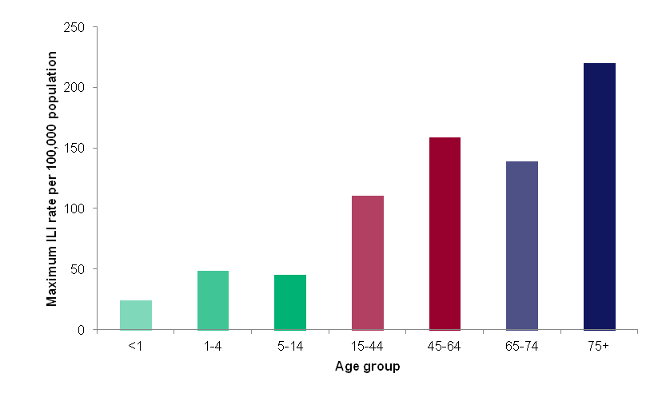
Scotland 2017/18 - Maximum ILI rate reached by age group

Slide 100
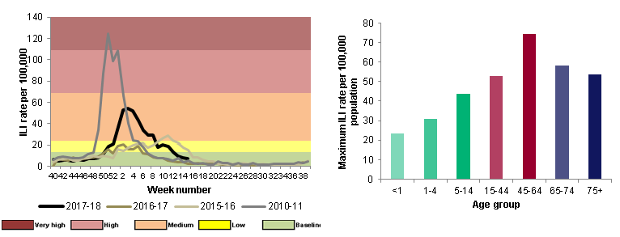
Overall weekly RCGP ILI rate, England, 2017-18
RCGP ILI consultation rates, England
Peak ILI rates by age groups, England
Season started with increase in outbreaks and GP ILI rate;
GP ILI peak rates reached moderate levels, not peak 10/11 level

Slide 101
Flu in the closed settings

Slide 102
Outbreaks of flu - Acute respiratory infection (ARI) outbreaks reported to HPS – 2014/15 to 2017/18

Slide 103
Hospitalisation – SMR data?
ISD provide HPS within PHI with SMR summary data
Data analysis monthly on ICD-10 diagnosis
This data is incomplete data for up to 3 months after discharge
Proxy measure available?
ECOSS data on laboratory detections of flu is largely from hospital samples
  However 2017/18 saw an explosion in Point of Care testing leading to difficulty in interpretation
  Is the number of positive tests reflective of genuine increase or artefact because of change in testing practice?
Severe Acute Respiratory Infection (SARI) in lab confirmed ICU cases

Slide 104
ECOSS – flu virology by week season 2017/18

Slide 105
ICU Flu cases - SARI
SARI cases in 2017/18
HPS report on week 51 data “Number of SARI deaths: three. Case fatality rate is low: 15.8% (3/19)”

Slide 106
Vaccine effectiveness?
Early and high number of flu outbreaks in well vaccinated elderly populations in care homes in Scotland was worrying
Highly suggestive of low vaccine effectiveness of the trivalent influenza vaccine in this population

Slide 107
UK Flu VE by TNCC ,Oct 2017–April 2018 – omitted as submitted for academic submission

Slide 108
UK Flu VE by TNCC ,Oct 2017–April 2018 – omitted as submitted for academic submission

Slide 109
Excess all cause mortality using NRS daily management data – EuroMOMO

Slide 110
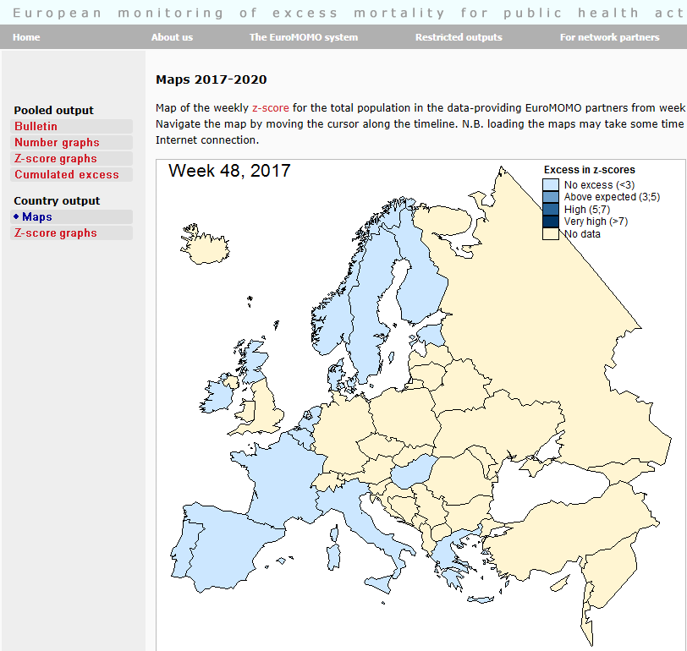

Slide 111
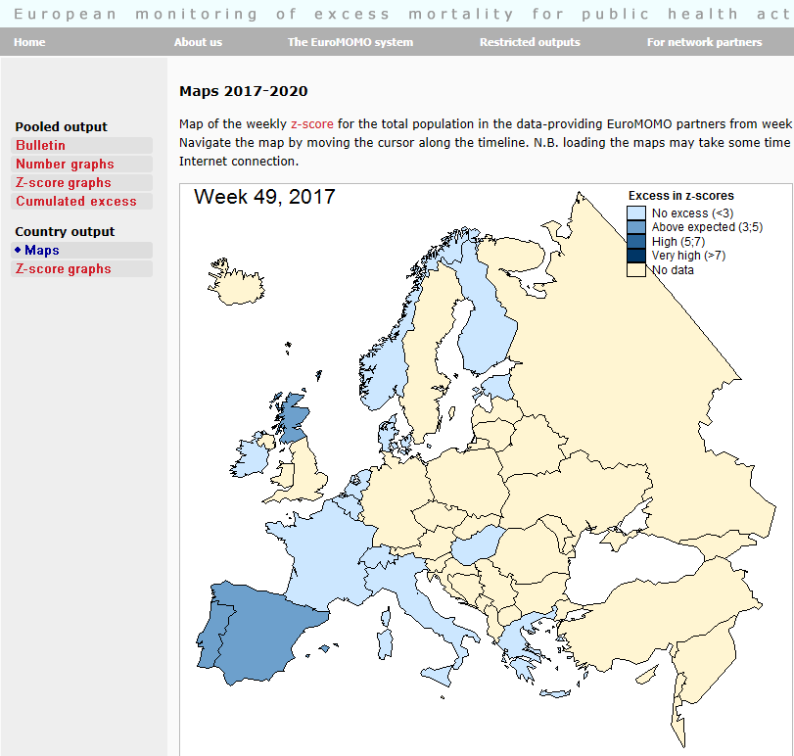

Slide 112
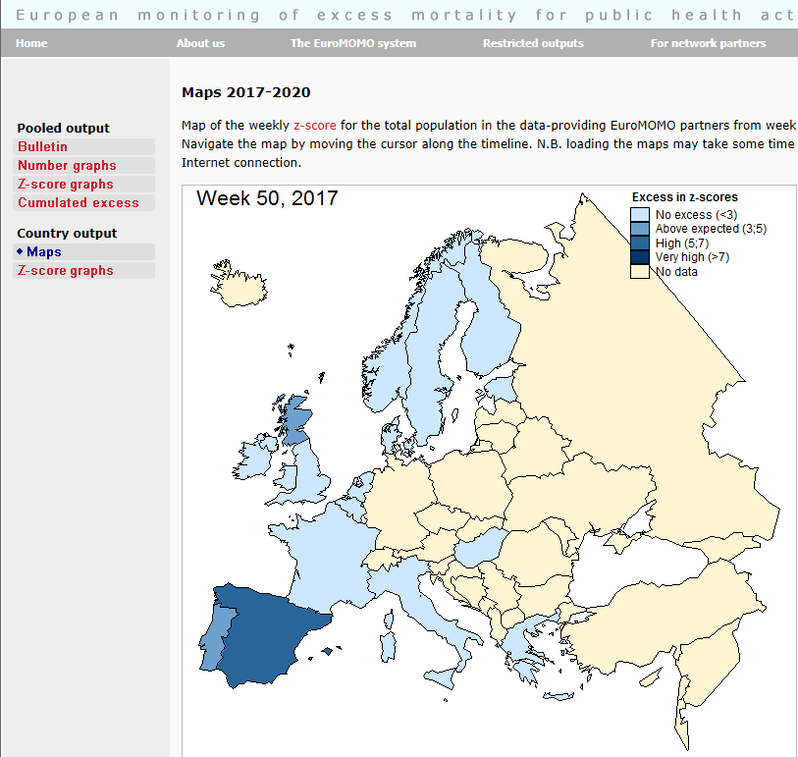

Slide 113


Slide 114


Slide 115


Slide 116


Slide 117


Slide 118


Slide 120


Slide 121


Slide 122


Slide 123
Flu associated mortality from NRS daily management data using the FluMOMO model

Slide 124
FluMOMO
Unpublished data omitted pending publication
FluMOMO modelled data is indicative that flu explained much of excess mortality, that low temperature did not explain the excess and that unmeasured confounding could only explain less than 20% of the excess in the elderly

Slide 125
End of season data-
Early SMR analysis
HPS data correlation
&
NRS official statistics on mortality

Slide 126
NRS Excess death data by week & by age group 2013 to 2017/18

Slide 127
HPS ECOSS Laboratory positive respiratory pathogens by season - 2009/10 to 2017/18

Slide 128
ISD SMR01 admissions with HPS ECOSS laboratory positive influenza tests seasons 2010/11 to 2017/18

Slide 129
HPS ECOSS data for dominant respiratory pathogens versus NRS mortality data 2009/10 to 2017/18 seasons

Slide 130
Correlation of HPS data with NRS excess deaths
 |  | GP ILI rates | ECOSS_pos % | Hosp | SARI | Outbreaks | GP_pos_% | Flu_pos_no
Deaths | Pearson Correlation² | 0.549** | 0.746** | 0.792** | 0.597** | 0.700** | 0.669** | 0.805**
 | Sig. (2-tailed) | 0.00 | 0.00 | 0.00 | 0.00 | 0.00 | 0.00 | 0.00
**. Correlation is significant at the 0.01 level (2-tailed)

Slide 131
Influenza & streptococcal crude 30 day mortality rates per 100,000 seasons 2010-2017/18

Slide 132
Conclusions
Influenza A (H3N2) dominated the 2017/18 winter season
Early indication of poor match between the 2017/18 seasonal vaccine was provided by an early increased number of outbreaks of flu in care homes
GP consultation rates and laboratory positives from hospital admissions were very high in those age 65 or more compared to previous seasons
Vaccine effectiveness could not be demonstrated in the elderly for GP consultations with laboratory confirmed influenza
EuroMOMO excess all cause mortality using NRS management data indicated highly statistically significant winter excess in those age 65 or more
FluMOMO modelled data is indicative that flu explained much of excess mortality, that low temperature did not explain the excess and that unmeasured confounding could only explain less than 20% of the excess in the elderly
End of season analysis demonstrates good correlation between a variety of seasonal influenza indicators and NRS excess all cause mortality
Linkage of HPS, ISD & NRS data demonstrates that influenza clinical and laboratory data is associated with a minority of NRS deaths - interpretation is limited by timing in relation to the clinical course of infection and in the absence of universal screening for flu at death
Though the burden of flu was most borne by the most elderly the 30 crude mortality rate in laboratory confirmed flu cases was similar to most previous seasons. The higher number of deaths was a likely consequence of the bigger pool of infected individuals in this age group.

Slide 133
Next steps
Draft report for presentation to the DCMO
In the absence of confidential patient review for deaths consider;
Further work on crude mortality
Piloting/Mandating flu PCR testing on all hospital deaths to ascertain detection rate and possible contribution of flu to these deaths
Compare and contrast results with a similar Coroner initiative in Navarra region, Spain
Work with EU colleagues to refine the FluMOMO model by age groups
Role of other possible explanatory variables in contributing to excess deaths including austerity
Spatial work to be combined with temporal work – not an insignificant task and will require funding.

Slide 134



Respiratory team
Chris Robertson
Statistician
Jen Bishop
Statistician
Karen Voy
Stephanie McAuley
Billy Malcolm
Pharmacy
Ross Cameron
Louise Primrose-Shaw
Eisin McDonald
Naoma William
Fiona Johnston
Diogo Marques
Kevin Pollock
Syed Ahmed
Arlene Reynolds
Jim McMenamin

Slide 135
Further acknowledgements
NHS boards
Scottish Government
Public Health England
EuroMOMO
European Centre for Disease Control
Epiconcept
EU Horizon 2020
World Health Organisation

Slide 136
Presentation 6
Gerry McCartney
NHS Health Scotland

Slide 137
Austerity and the economic downturn
Gerry McCartney
13th November 2018

Slide 138
Background
Hypotheses are most closely associated with the work of Danny Dorling, Lucinda Hiam, Martin McKee, Aaron Reeves, and their teams
We couldn’t get them, so you need to put up with me (alongside the risks of me misrepresenting their work)
‘Austerity’ is a bit of a catch-all term for a range of different pathways
Many publications look at the association between ‘austerity’ and other outcomes (esp. mental health, but also cause-specific mortalities)

Slide 139
Austerity across Europe (2009-2011)

Slide 143


Slide 145
Hypothesised pathways
Elderly
  Reduced or insufficient service provision (esp. social care/NHS) and/or changed distribution/accessibility of service
  Decreased value of Pension Credit
Working age and children
  Reduced value and increased conditionality of social security (inc. sanctions, change in benefits and problems with how they have been implemented)
  Unemployment
  Decreased real value of wages
  Increased employment precarity, work intensity and reduced sense of control

Slide 146
Broader age impacts
  Homelessness, poorer housing quality
  Food/fuel insecurity
  Increased poverty (esp. child poverty) and income inequality
  Increase in state pension age

Slide 147
Evidence testing this hypothesis for all-cause mortality

Slide 152
…and examples for specific outcomes

Slide 153

Self-rated health (Europe 2002-2014)

Slide 154

Suicide across Europe and Active Labour Market Programmes

Slide 155
Suicide and infectious disease

Slide 156
Mental health problems

Slide 159
Delayed discharges

Slide 160
Budget cuts and homelessness
Disability assessments and suicide
Austerity and mental health
Benefit conditionality and mental health
NHS service distribution

Slide 161
Summary so far
There is substantial evidence of an association between different aspects of austerity and worse health derived from studies:
  Within countries
  Between countries
  For many specific outcomes
…but there is evidence of selectivity of outcomes
Little synthesis across studies
No definitive study of evidence linking all-cause mortality and a range of aspects of austerity within Scotland/UK or between nations

Slide 162
An example of possible interactions

Slide 163
Increased mortality
Austerity/ macroeconomic/ labour market/ social security policy

Slide 164
Increased mortality
Insufficient social care resources
Austerity/ macroeconomic/ labour market/ social security policy
Increased acute care waits
Insufficient NHS resources
Increased health care needs

Slide 165
Increased mortality
Insufficient social care resources
Austerity/ macroeconomic/ labour market/ social security policy
Increased acute care waits
Insufficient NHS resources
Increased health care needs
Influenza

Slide 166
Increased mortality
Insufficient social care resources
Austerity/ macroeconomic/ labour market/ social security policy
Increased acute care waits
Insufficient NHS resources
Increased health care needs
Influenza
Ineffective vaccine

Slide 167
Increased mortality
Insufficient social care resources
Austerity/ macroeconomic/ labour market/ social security policy
Increased acute care waits
Insufficient NHS resources
Increased health care needs
Influenza
Ineffective vaccine
Vulnerable population (minimal flu ‘harvesting’ prior to 2015)

Slide 168
Increased mortality
Insufficient social care resources
Austerity/ macroeconomic/ labour market/ social security policy
Increased acute care waits
Insufficient NHS resources
Increased health care needs
Vulnerable population due to increased obesity
Influenza
Ineffective vaccine
Vulnerable population (minimal flu ‘harvesting’ prior to 2015)

Slide 169
Discussion
These hypotheses can be challenging for some agencies to talk about as they are inherently political.
The available evidence is limited by the available data, but supports a conclusion that these exposures are part of the causal pathway(s) leading to recent mortality trends.
It is plausible that the austerity hypotheses are complementary to other hypotheses.
More work to test the austerity hypotheses, particularly using international comparisons, should be undertaken.
How important this hypothesis, and how much of the trends it explains, needs to be clarified.
Interactions between hypotheses are very plausible and likely, but plausibility does not mean they are all real or important.

Slide 170
Presentation 7
Gerry McCartney
NHS Health Scotland

Slide 171
Hypotheses to explain the recent mortality trends (in no particular order)
Gerry McCartney
13th November 2018

Slide 172
Outline
Single hypotheses listed under overall themes
Possible interactions shown in illustrative causal diagrams
….Not in any particular order

Slide 173
Artefact
  Standard population change
  Ageing population
  Denominator change – returning elderly from EU (salmon bias)
  Cohort passing into less accurately enumerated population group (90+ years)
Attainment of natural limit to lifespan
Migration
  Eastern European in-migration

Slide 174
Weather
  Cold, snow/ice
  Heat
Influenza
  Virulent strain
  ‘Harvesting’
  Vaccine-strain mismatch
  Interactions – vulnerable cohort from historical exposure; austerity/services under strain; austerity/people made vulnerable.

Slide 175
Austerity and economic downturn
  Elderly
    Reduced or insufficient service provision (esp. social care/NHS) and/or changed distribution/accessibility of service
    Decreased value of Pension Credit
  Working age and children
    Reduced value and increased conditionality of social security (inc. sanctions, change in benefits and problems with how they have been implemented)
    Lagged effects of unemployment
    Decreased real value of wages
    Increased employment precarity, work intensity and reduced sense of control
  Broader age impacts
    Homelessness, poorer housing quality
    Food/fuel insecurity
    Increased poverty (esp. child poverty) and income inequality
    Increase in state pension age

Slide 176
Obesity
  Increased mortality/morbidity due to obesity
  Interaction with influenza
Loneliness/decreased social networks
  Lack of social support, especially among the elderly

Slide 177

Hill AB. The Environment and Disease: Association or Causation? Proc R Soc Med 1965; 58: 295–300.

Slide 178
Are there any other approaches that might be useful?

Slide 179
Rothman’s component cause model
exposure to influenza virus
older age
stress on social care
unknown factor
exposure to influenza virus
older age
vaccine mismatch
unknown factor
exposure to influenza virus
multiple co-morbidity
A&E performance
unknown factor

Slide 180

Directed Acyclic Graphs
back door path
  (confounder)
collider
mediator

Slide 181
Presentation 8
Colin Fischbacher
NSS ISD

Slide 182
Observational evidence, causal conclusions
Colin Fischbacher

Slide 183
Understanding mortality trends
evidence about the causes of current mortality trends is inevitably observational
assessing whether an association is likely to be causal inevitably involves a degree of judgement
given the controversy over competing explanations, it is important that the assessment of associations is as objective as possible
might a standard approach - such as that offered by the Bradford Hill criteria - be helpful?

Slide 184
1. Strength of association
a stronger association may be more likely to represent a causal effect
however initial small studies may produce extreme results which are not confirmed in subsequent research
some important exposures (eg environmental ones) have potentially large population effects even though the relative risk is small

Slide 185
2. Consistency
an association is more likely to represent a causal relationship if the same association is found in different studies in different populations using different designs
I suggest likely to be helpful – and inconsistent findings would clearly be a problem
however doesn’t seem essential – for example some causes may be stronger in some populations

Slide 186
3. Specificity
if the association is specific to one exposure and one outcome then it is more likely to be causal than if there are changes in multiple outcomes
this criterion may be less helpful since many potential causes (such as socio-economic ones) are likely to impact on a wide range of outcomes
even more specific causes like flu may impact on a range of outcomes, and not just on respiratory disease

Slide 187
4. Temporality
the exposure must have happened before the outcome
also useful where levels of exposure vary widely over time but are strongly correlated with outcomes at all time points
broader secular trends correlated with trends in outcomes are vulnerable to confounding (eg broadband speed correlated with mortality increases)

Slide 188
5. Dose-response relationship
a causal relationship is more likely if the risk of the outcome increases with increasing levels of exposure
likely to be a useful criterion
however still need to bear in mind the possibility that the exposure is correlated with another confounder (eg the more books you own the lower your mortality)

Slide 189
6. Biological plausibility
association is more likely to represent causation if there are plausible biological mechanisms – eg tars in cigarettes – no plausible mechanism (eg an association between breast cancer rates and the price of houses) makes causality unlikely
a somewhat helpful criterion
however there are often plausible mechanisms but no causal relationship (eg an infant sleeping on their back may inhale vomit)
and there are often no known mechanisms for real causes (eg cholera in the time of Snow)

Slide 190
7. Coherence
the proposed causal relationship shouldn’t conflict with what we already know about the problem
for example, does smoking cause lung cancer?
lung cancer increased as the prevalence of smoking rose and was originally more commen in men, who tended to smoke more; there are pre-cancerous changes in the bronchial epithelium among smokers
this criterion may be less useful – it overlaps somewhat with plausibility

Slide 191
8. Experiment
if intervening to cause an exposure (eg to a drug) produces the outcome then the association is likely to be causal
very convincing, but feasibility is a concern – ie you couldn’t ethically allocate harmful exposures
however you could randomly allocate measures to reduce the impact of a suggested exposure – eg universal basic income, flu vaccination

Slide 192
9. Analogy
if we are proposing novel mechanisms (for example a drug given to a pregnant woman might harm her fetus) is there an analogous example that might justify a causal suggestion?
eg – thalidomide damaged children, so perhaps this drug might too
not clear that this criterion is particularly useful here

Slide 193
Hill AB. The Environment and Disease: Association or Causation? Proc R Soc Med 1965; 58: 295–300.

Slide 194
Are there any other approaches that might be useful?

Slide 195
Rothman’s component cause model
exposure to influenza virus
older age
stress on social care
unknown factor
exposure to influenza virus
older age
vaccine mismatch
unknown factor
exposure to influenza virus
multiple co-morbidity
A&E performance
unknown factor

Slide 196
Directed Acyclic Graphs
back door path
  (confounder)
collider
mediator

Slide 197
Summing up
Inevitably much of the evidence around mortality trends is observational
We need to take an objective and consistent approach to assessing this evidence
do causal criteria like those of Bradford Hill help with this process?
are there other possible approaches that might be useful?

Slide 198
Summing up

