Slide 1
National Burden of Disease Study Country overview: Germany
Elena von der Lippe

Slide 2
Who are you (and what your role is)
The Robert Koch Institute (RKI) is one of the most important institutes of public health in Germany. As leading institution of the government in the field of biomedicine it plays a major role in the prevention and combating of infectious diseases as well as in the analysis of long-term public health trends in health.

Slide 3
Who are you (and what your role is)
Department 2: Epidemiology and Health Monitoring: The main topics handled in this department are the significant challenges and burdens placed on the population in general and the healthcare system in particular. These challenges are characterised by rapidly changing working and living conditions, demographic change, the increase in life expectancy and associated ageing of the population, and the shift in the spectrum of diseases towards chronic-degenerative and mental illnesses.

Slide 4
Who are you (and what your role is)
Unit 24 Health Reporting
Federal Health Reporting analyses and describes the state of health of the German population, their health-related behaviour, the prevalence of risk factors, the use of healthcare services, and the costs and resources of the healthcare.

Slide 5
History of BOD in your country

Slide 6
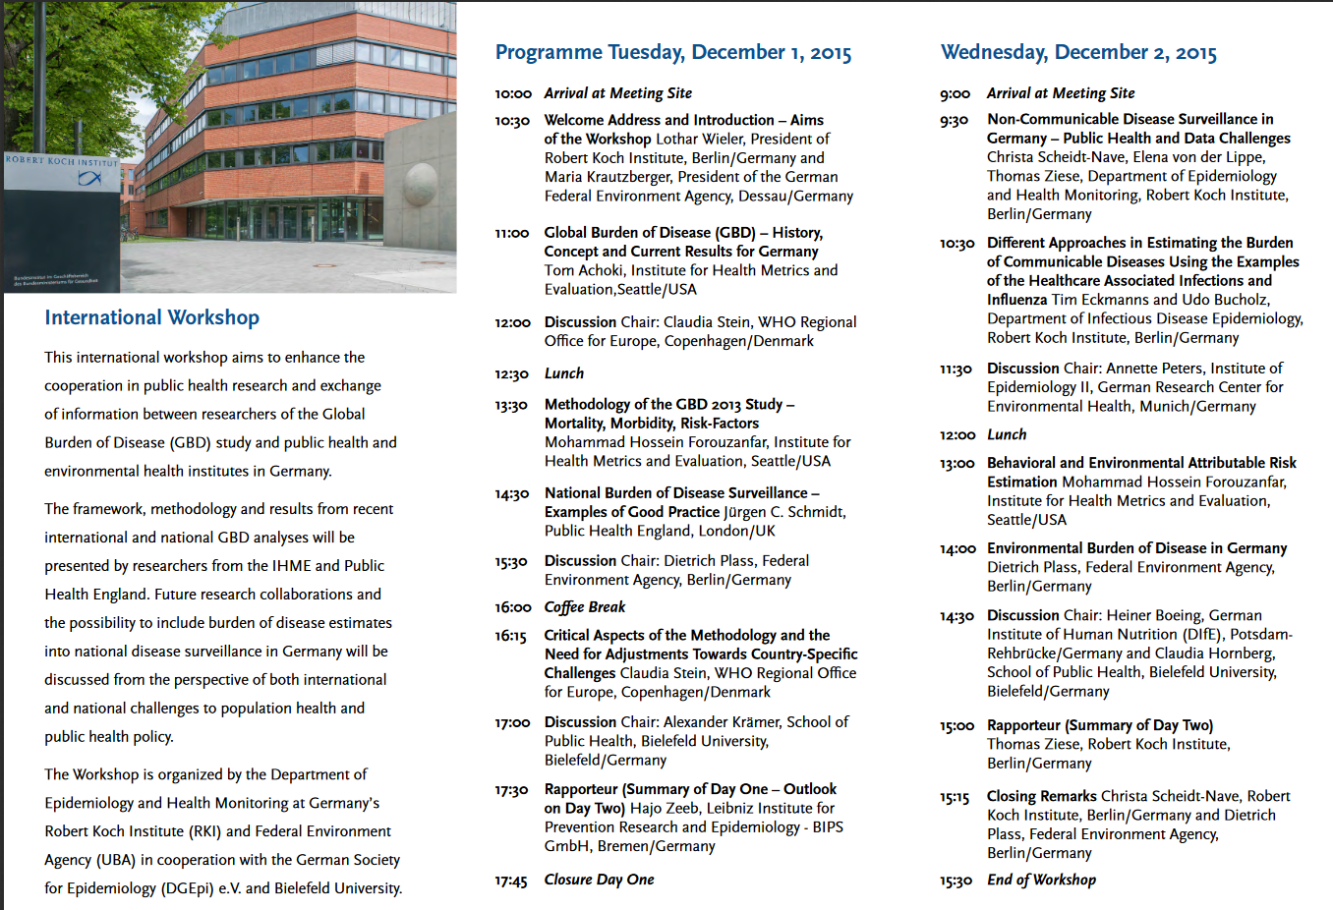
History of BOD in your country

Slide 7
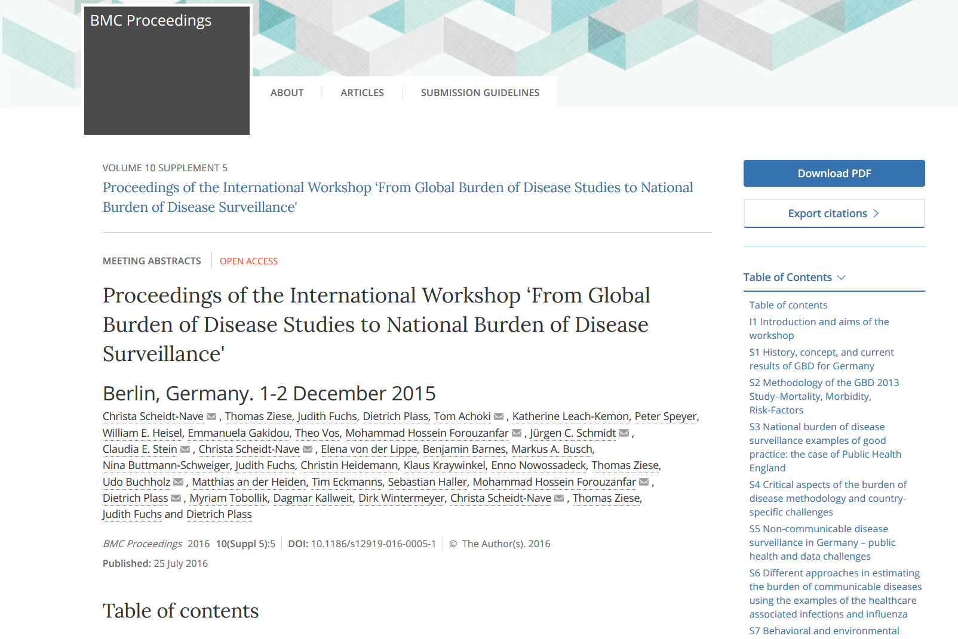
History of BOD in your country

Slide 8
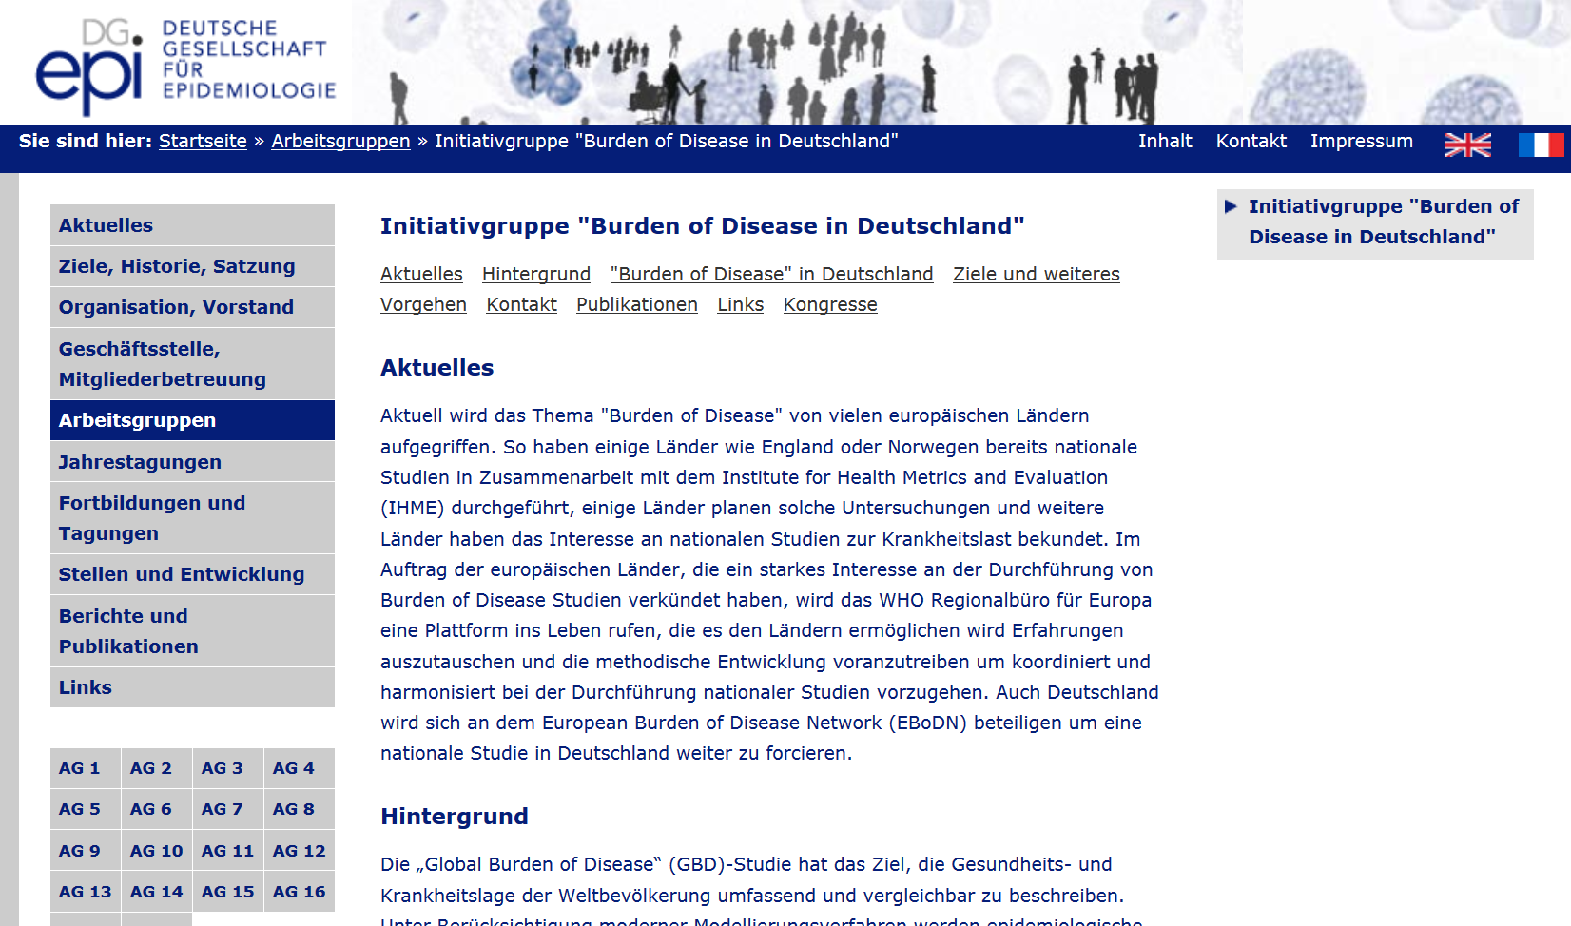
History of BOD in your country

Slide 9
What are you currently doing
We have started an initiative group with the aim to increase the network and to involve other institutions in order to successfully carry out a national study.
The RKI can play a leading role as it has the responsibility for the health reporting in Germany. The Federal Environment Agency (UBA) would be responsible for the area of the Environmental Burden of Disease.
Possible ways of financing are discussed.

Slide 10
Plans for the future
Preparation of the topic-specific data needed for national Burden of Disease study on regional and national level, identifying data gaps.
Development of a national indicator-based surveillance , including communicable and non-communicable diseases (for instance: Diabetes-Surveillance)
Further content and methodology development , for instance for detecting social inequality or gender differences in the burden of disease, or better identification of age-related health problems and the burden of disease of very old population, to quantify adverse health effects ("disability weights")
To have a regular international exchange through workshops and training programs.

Slide 11
Current and future collaboration
We are looking for collaborators on national and international level

Slide 12
What do you hope to get out of the workshop
Connect to network of experts working on national burden of disease studies
Learn from the experience of the others
Get ideas and inspiration for possible collaborations and methods for conducting national BD study

